Slide 1


Improving adaptability and resilience of perennial ryegrass for safe and sustainable food systems through CRISPR-Cas9 technology - EditGrass4Food
«Edit Grass 4 Food», kick-off meeting
Riga, 8th October, 2021
“EditGrass4Food”, ID No EEA-RESEARCH-64, Contract No EEZ/BPP/VIAA/2021/4
is financially supported by European Economic Area (EEA) grants

Slide 2




Project partners
University of Latvia
Norwegian University of Life Sciences
Lithuanian Research Centre for Agriculture and Forestry
Tallinn Technical University

Slide 3
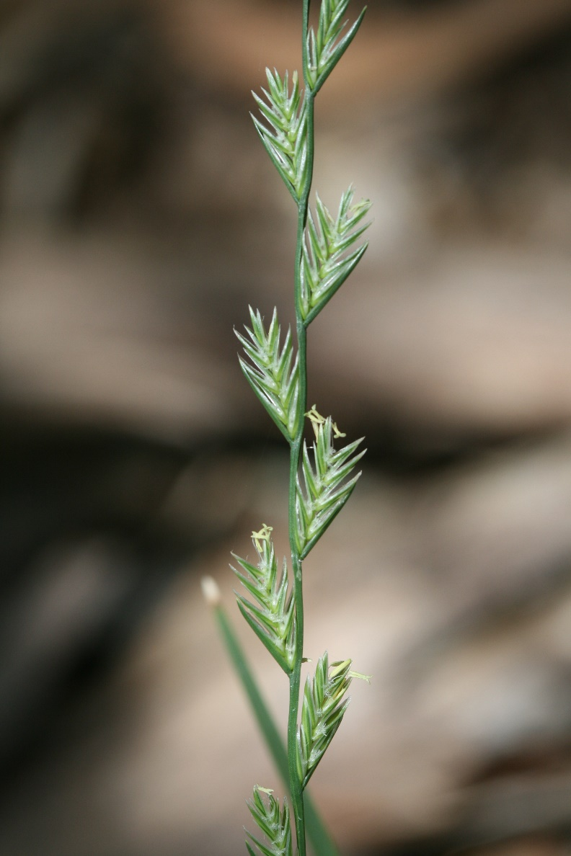
Lolium perenne
Lolium perenne (latv. daudzgadīgā airene, engl. perennial ryegrass)
Native to Southern Europe, the Middle East and North Africa
Important pasture and forage plant, extensively used in seed mixes
High yield in fertile soil
Lacks adaptation to climate conditions in Nordic and Baltic region, but due to the climate change this situation can change
For cultivation in Nordic and Baltic countries perennial ryegrass needs improved freezing and drought tolearance
Notes:
It may be surprising, but Baltic winters with repeated freeze – thaw cycles are particularly bad for ryegrass. The same for summers – it is common to have periods of several weeks without rain, which strongly reduces the yield.

Slide 4
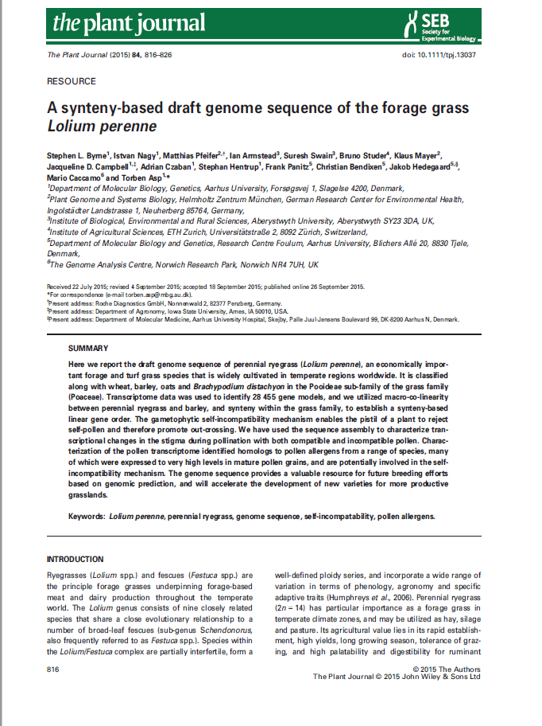
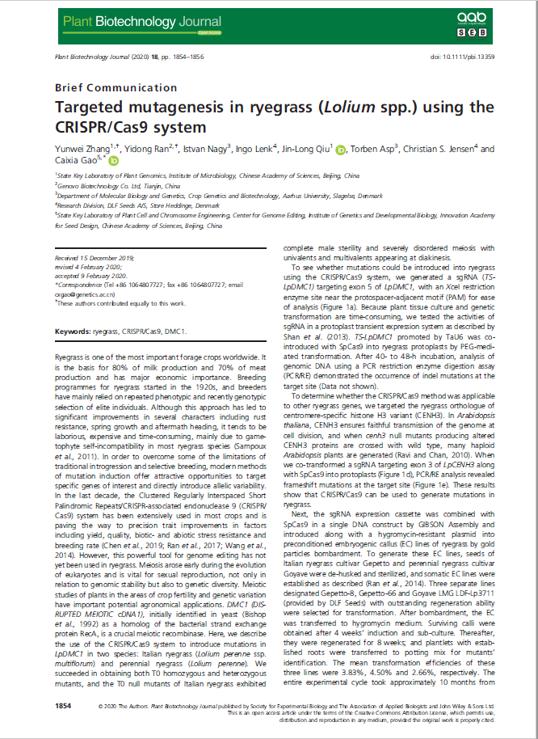
L. perenne genomic resources
Notes:
It may be surprising, but Baltic winters with repeated freeze – thaw cycles are particularly bad for ryegrass. The same for summers – it is common to have periods of several weeks without rain, which strongly reduces the yield.

Slide 5
Aim and objectives
Aim of the project is to utilize transcriptomics and functional genomics to increase sustainability in agriculture through improvement of perennial ryegrass with better adaptation to frost and drought for current and future climates.
1. Establish a diverse perennial ryegrass core association panel by utilization of data from ongoing projects (WP1),
2. Screen the association panel in order to detect haplotype-resolved single-nucleotide variants and structural variation in the targeted genes/alleles for freezing and drought genes (WP1),
3. Identify novel genes and characterize drought and freezing tolerance genes by comparing their expression for pathway related genes in non-edited and mutant plants (WP2),
4. Develop CRISPR-Cas9 constructs and generate CRISPR-edited perennial ryegrass mutants for freezing and mild drought tolerance (WP3),
5. Validate and characterize the role of the genes and their sequence variations in the freezing and drought mechanisms (WP4).

Slide 6
WPs
WP1. Establishment and screening of perennial ryegrass association panel for freezing and drought related traits. Coordinator: NMBU; Involved partners: NMBU, LAMMC
WP2. Transcriptome regulation of freezing and drought tolerance in perennial ryegrass. Coordinator: NMBU; Involved partners: NMBU, LAMMC
WP3. Functional characterization of frost and drought candidate genes in perennial ryegrass by CRISPR-Cas9. Coordinator: TalTech; Involved partners: LU, NMBU
WP4. Validation of improved freezing and water shortage tolerance. Coordinator: LAMMC; Involved partners: TalTech, NMBU, LU
WP5. Management and coordination of research activities and dissemination of results. Coordinator: LU; Involved partners: TalTech, NMBU, LAMMC

Slide 7
Deliverables
Publications
  4 papers and 1 book chapter (open access)
Project meetings:
  kick-off meeting (2021, Latvia), annual meeting (2022 in Estonia), workshop (2023, Lithuania), final conference (2024, Latvia)
Scientific achievements
  association mapping panel, transcriptome sequences, 10 gene edited plants assessed for drought tolerance, 4 PhD students
Joint application for Horizon Europe funding
Project interim/final reports – June 2022, June 2023, May 2024

Slide 8
Genome editing
Genome editing is a set of techniques for introducing targeted changes in genomes
Genome editing is similar to site-directed mutagenesis
Genome editing is be achieved by enzymes collectively called site-directed nucleases (SDN)
In general, there are two types of SDNs:
  1) DNA recognition is achieved by protein domain (TALEN, ZFN)
  2) DNA recognition is achieved by complementary RNA molecule (CRISPR/Cas9)

Slide 9
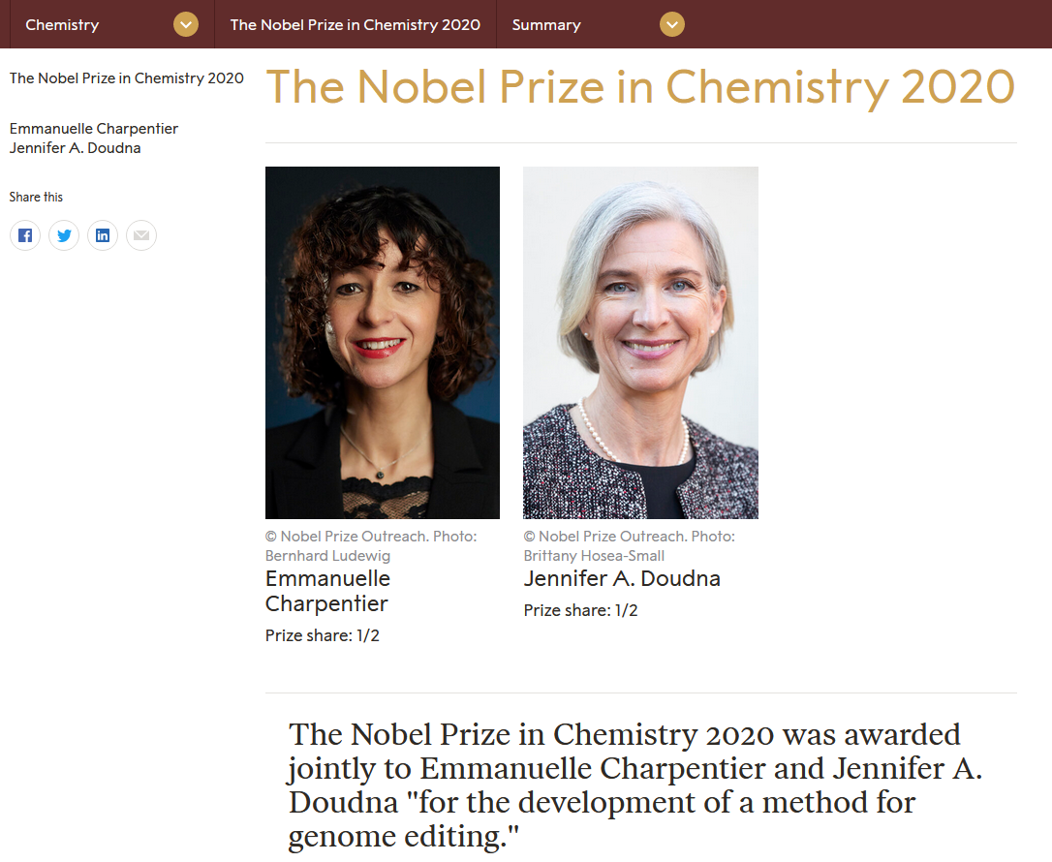
https://www.nobelprize.org/prizes/chemistry/2020/summary/
Notes:
Emmanuelle Charpentier
Max Planck Unit for the Science of Pathogens, Berlin, Germany
Jennifer A. Doudna
University of California, Berkeley, USA

Slide 10
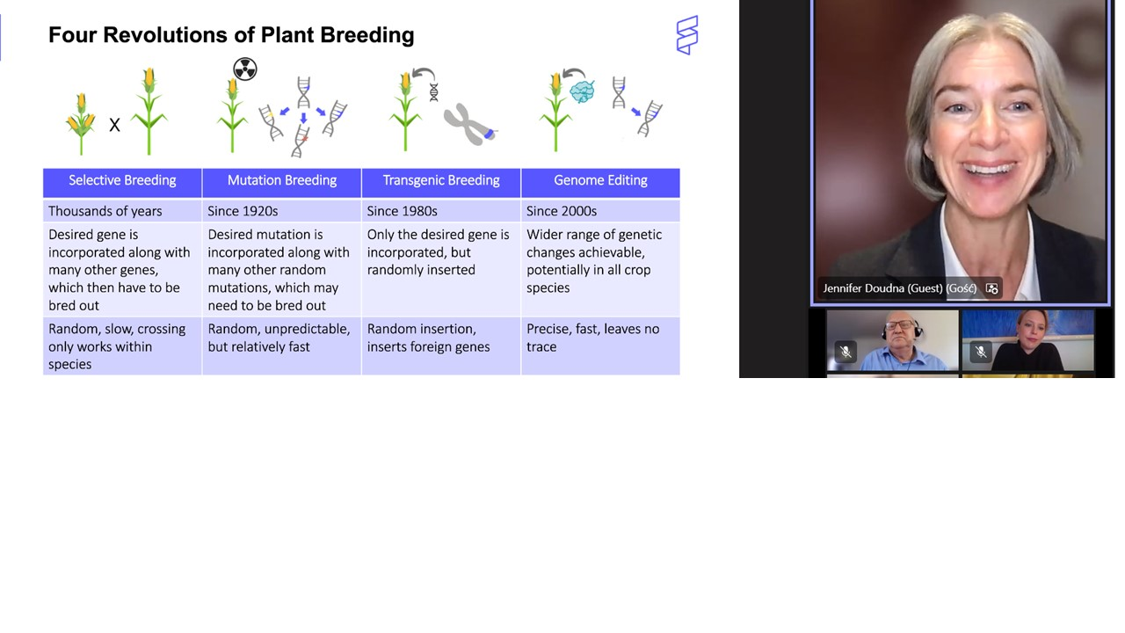
"CRISPR leads to the same alterations that happen in nature but much faster and much more precise. More precision leads to more safety. This enabling tool opens the door to obtain better agricultural products" https://twitter.com/InzeDirk/status/1445403656673705993
Notes:
Emmanuelle Charpentier
Max Planck Unit for the Science of Pathogens, Berlin, Germany
Jennifer A. Doudna
University of California, Berkeley, USA

Slide 11
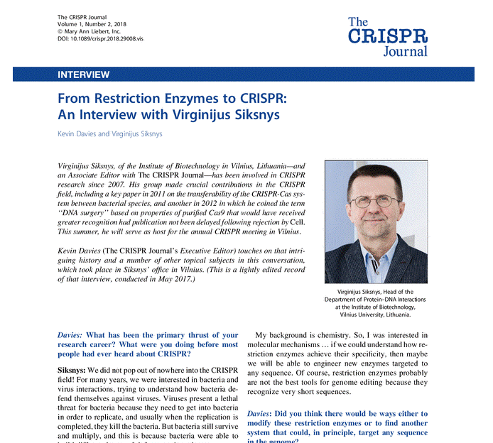
Virginijus Siksnys
Viļņas Biotehnoloģijas institūts
Notes:
It is also the closest that a scientist from any of the Baltic states has come to be considered for Nobel prize. Got another prestigious Kavli prize instead.

Slide 12
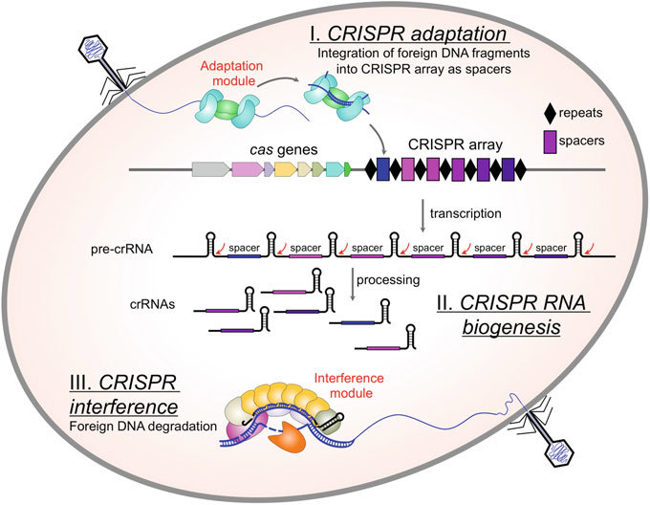
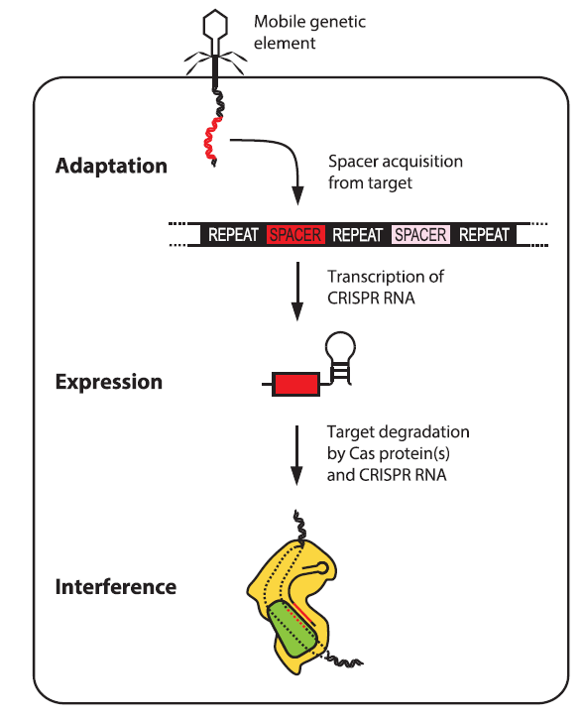
Natural adaptive CRISPR/Cas9 immune system from bacteria
Semenova E, Severinov K (2017) Interdependencies Between the Adaptation and Interference Modules Guide Efficient CRISPR-Cas Immunity. pp 51-62
Rath et al. (2015) The CRISPR-Cas immune system: Biology, mechanisms and applications. Biochimie, 117:119
Notes:
Dzīvniekiem ir uz šūnām un proteīniem balstīta imūnā sistēma, kas atšķir savējo no svešā. Baktērijām ir uz DNS balstīta imūnā sistēm.

Slide 13
Genome editing with CRISPR/Cas9
Paul and Qi (2016) CRISPR/Cas9 for plant genome editing: accomplishments, problems and prospects. Plant Cell Rep, 35:1417.

Slide 14
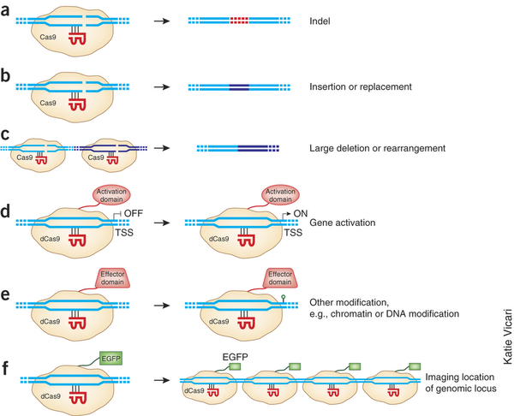
CRISPR/Cas9 system has many different applications
Sander, J.D., and Joung, J.K. (2014). CRISPR-Cas systems for editing, regulating and targeting genomes. Nat Biotech 32, 347-355.

Slide 15
Base editors
CRISPR-Cas9 base editors (adapted from Kantor et al. (2020; Komor et al. (2017). Panel A shows the two main types of base editors which are based on dCas9 complex fused with cytidine or adenine deaminases, respectively. Panel B shows detailed change of a G:C base pair into A:T base pair using dCas9 – cytidine deaminase complex
Notes:
Uzsvērt, ka slāpekļa bāzu editori sastāv no dCas, bet retāk no nCas enzīma, kas apvienots vienā molekulā ar adenīna vai citidīna dezamināzi.

Slide 16
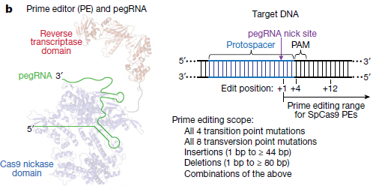
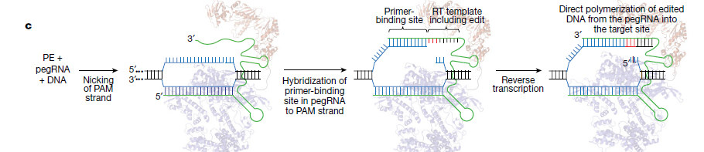
Prime editors
Anzalone et al. (2019) Search-and-replace genome editing without double-strand breaks or donor DNA. Nature 576:149–157
Notes:
Praimredaktoru struktūra un darbības shēma (adaptēts no Anzalone et al. (2019). A panelis – praimrediģēšanas komplekss sastāv no nCas9 (enzīms, kas veido tikai vienpavediena DNS pārrāvumu), kuram pievienots reversās transkriptāzes domēns (spēj sintezēt DNS uz RNS matricas), kā arī pegRNS. B panelis – praimrediģēšanas kompleksa darbības mehānisms DNS līmenī, kā arī rediģēšanas veidi un diapazons. C panelis – praimrediģēšanas komplekss piesaistās pie mērķa DNS sekvences un veic vienpavediena DNS pārrāvumu PAM ķēdē. DNS 3’ gals hibridizējas ar pegRNS praimera hibridizācijas saitu un kalpo par starta vietu jaunas DNS molekulas apgrieztajai transkripcijai, kas saturēs pegRNS molekulā kodēto rediģēto sekvenci.

Slide 17
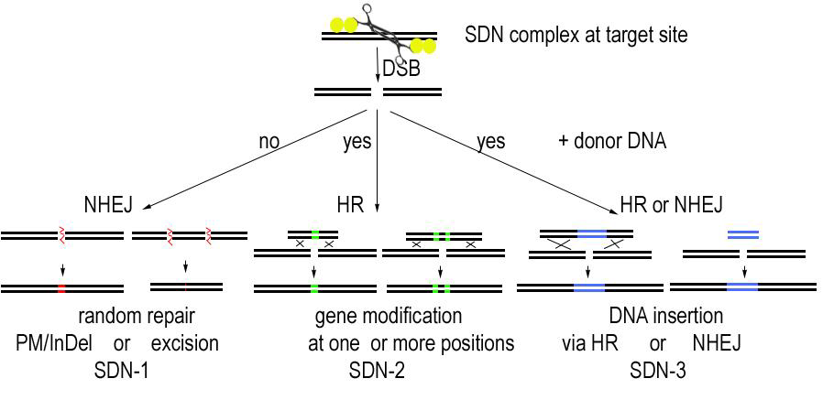
Site-directed nucleases and scenarios for genome modification
EFSA GMO Panel (2012) Scientific opinion addressing the safety assessment of plants developed using Zinc Finger Nuclease 3 and other Site-Directed Nucleases with similar function. EFSA J, 10:2943. doi:10.2903/j.efsa.2012.2943
Notes:
What are SDN-1, SDN-2 and SDN-3?
Initially developed for ZFN and TALEN, CRISPR/Cas9 or similar nuclease also fits within this framework.
SDN-3 results in conventional GMOs, but SDN-1/2 do not contain foreign DNA and in principle produce mutations.

Slide 18
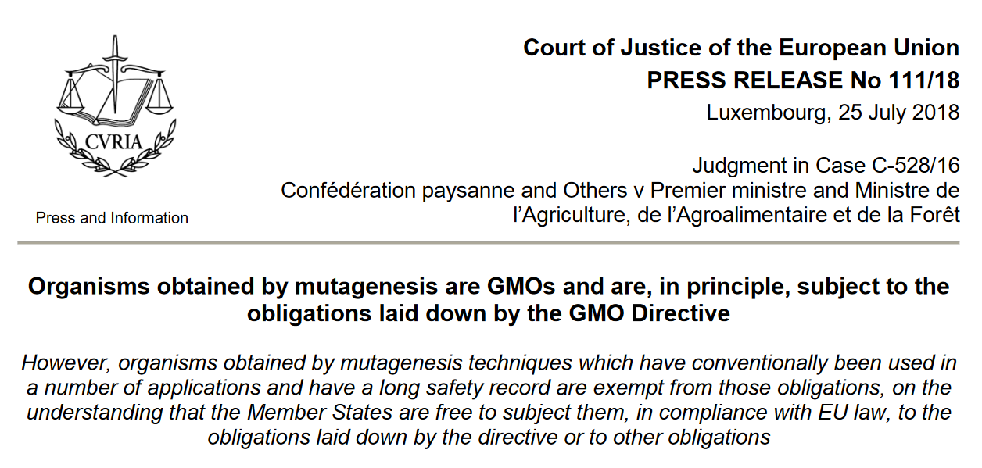
Organisms obtained by mutagenesis (including genome editing) are GMO
Notes:
Many of the new breeding techniques including SDN1/2, CRISPR and such can be considered as a form of mutagenesis. ECJ found that organisms obtained by the new mutagenesis techniques are subject to the GMO directive. Now the interpretation is that organisms obtained by mutagenesis are GMO, but some of them (conventional) are exempt from GMO legislation. The new mutagenesis techniques are subject to GMO Directive.

Slide 19
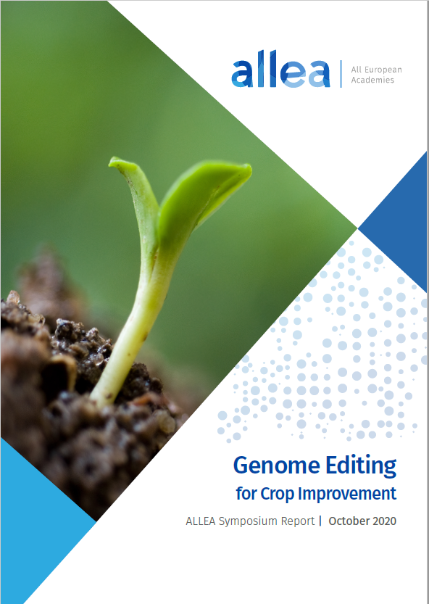
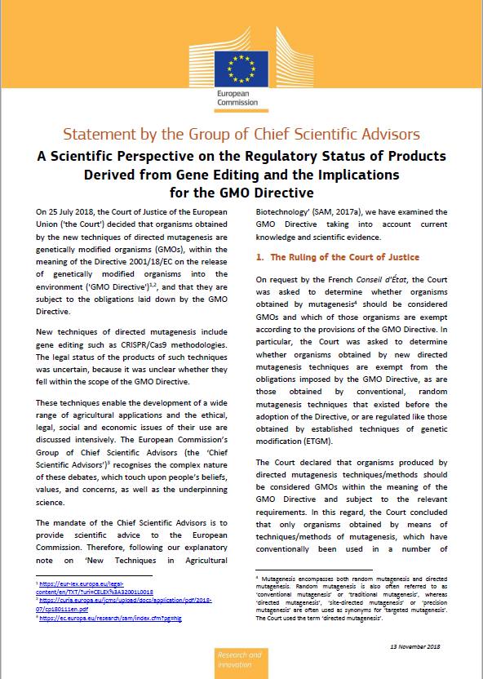
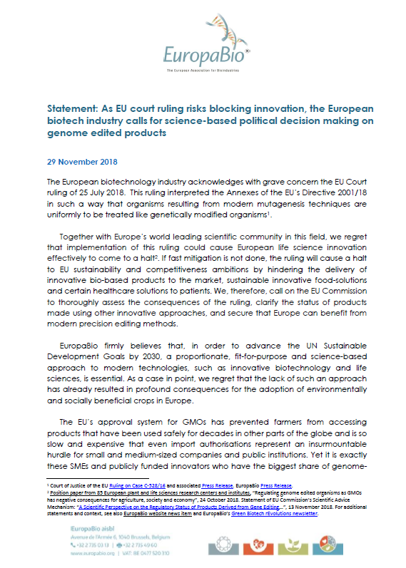
Notes:
This ruling caused an outcry in industry and academia.

Slide 20
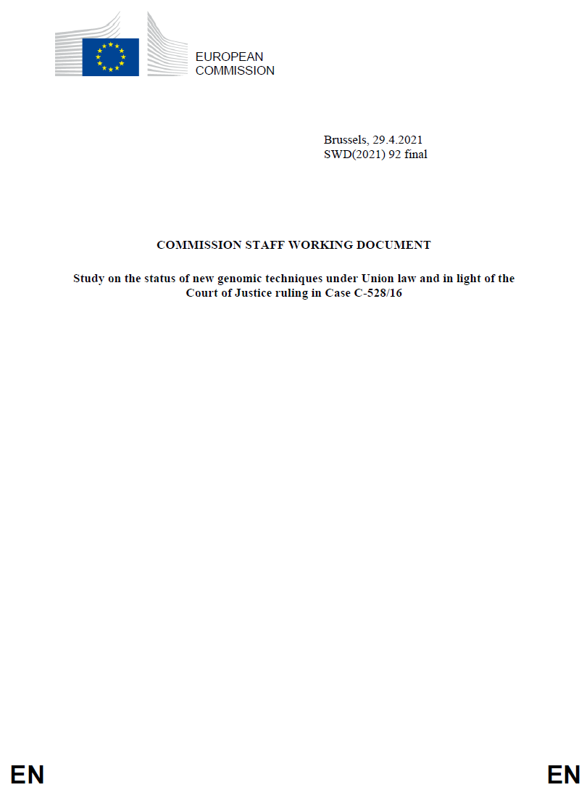
EC study on new genomic techniques
The Council of the European Union asked for the study, regarding the status of new genomic techniques under Union Law (Directive 2001/18/EC, Regulation (EC) 1829/2003, Directive 2009/41/EC and Regulation (EC) 1830/2003), in light of the Court of Justice’s judgment in Case C-528/16
Notes:
The Council of European Union is the highest decision making institution in the EU, but it is not legislative institution. If the Council decides that new legistlation on GMOs is needed, it will go to European Parliament. Eiropas Savienības Ministru Padome jeb Eiropas Savienības Padome ir galvenā un augstākā Eiropas Savienības lēmējinstitūcija, taču tai nav likumdošanas iniciatīvas. ES MP sastāv no ministriem, kas ir ES dalībvalstu valdību pārstāvji

Slide 21
EC study on new genomic techniques
Scope of the study:
A scientific and market state-of-the-art analysis
Clarification of the legal status of organisms produced by NGTs
A state-of-play on the implementation and enforcement of the GMO legislation, as regards NGTs
Safety and risk assessment considerations
An overview of research and innovation in the field
EU countries and stakeholders views on potential benefits/opportunities and challenges/concerns associated with NGTs and their products, labelling, Small and Medium Enterprises (SMEs), intellectual property
Information on public dialogues and national surveys
Information on ethical aspects of NGTs and their products

Slide 22
EC study on new genomic techniques
Study methodology:
Targeted consultation with stakeholders including Member States and 58 industry associations, academic and non-governmental organizations
An overview from the European Food Safety Authority including:
    EFSA own Scientific Opinions
    Member State Competent Authority Opinions
Two reports from the Joint Research Centre
Expert opinion from:
    Group of Chief Scientific Advisors
    European Network of GMO Laboratories
    European Group on Ethics in Science and New Technology

Slide 23
Existing EFSA risk assessment framework for new genomic techniques
EFSA 2012 – cisgenesis/intragenesis
EFSA 2012 – SDN-3 opinion (same as ZFN-3)
EFSA 2020 – SDN-1, SDN-2 and ODM opinion
EFSA 2021 – SynBio Plant opinion

Slide 24
Risk assessment flowchart for genome-edited organisms
Is foreign DNA present in genome-edited organism?
NO!
Standard GMO RA
However, less information and more flexibility required
Less information needed for molecular characterization, food and feed safety assessment and environmental risk assessment. Comparative approach still maintained.
YES!
Standard GMO RA
Notes:
For RA of genome-edited plants we still follow the comparative risk assessment strategy. The focus should be on the new trait conferred by the change in endogenous gene(s). Even more flexibility needed for SDN1/2 than for SDN3. A key question is about appropriate comparator, particularly in the case of editing multiple genes.

Slide 25
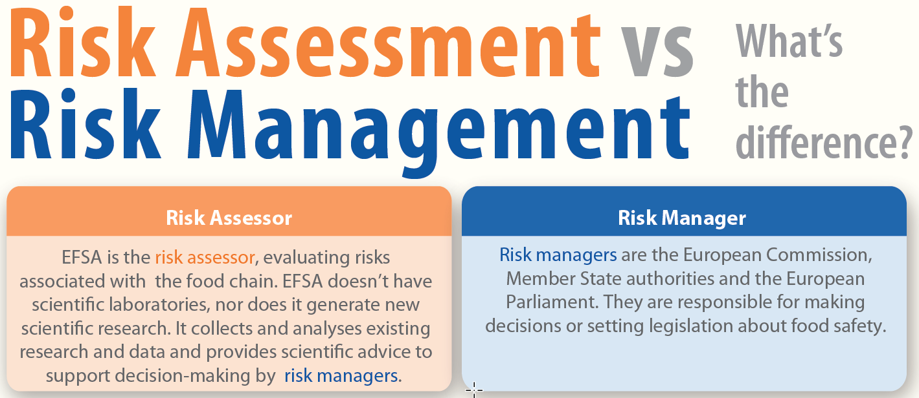
https://www.efsa.europa.eu/en/press/news/140416M

Slide 26
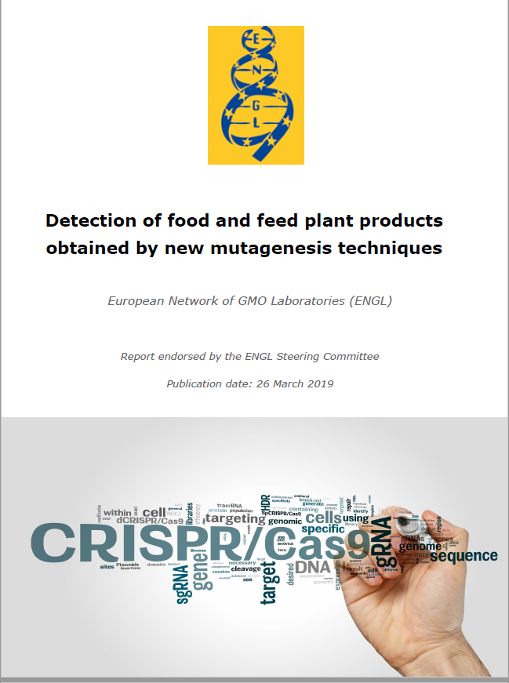
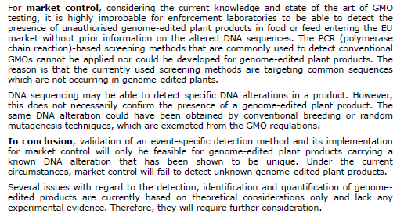
https://gmo-crl.jrc.ec.europa.eu/doc/JRC116289-GE-report-ENGL.pdf

Slide 27
Genome editing may be undistinguishable from natural and induced mutations
EHVLPMIPSGGAFKDMI ALS Triticum aestivum wt
EHVLPMIPNGGAFKDMI ALS Triticum aestivum + EMS
EHVLPMIPNGGAFKDMI ALS Triticum aestivum + γ
EHVLPMIPNGGAFKDMI ALS Triticum aestivum + CRISPR/Cas9
EHVLPMIPNGGAFKDMI ALS Triticum aestivum + ?
Lee, H., Rustgi, S., Kumar, N., Burke, I., Yenish, J. P., Gill, K. S., von Wettstein, D., Ullrich, S. E., 2011. Single nucleotide mutation in the barley acetohydroxy acid synthase (AHAS) gene confers resistance to imidazolinone herbicides. Proceedings of the National Academy of Sciences 108, 8909-8913.
Li, Y., Zhu, J., Wu, H., Liu, C., Huang, C., Lan, J., Zhao, Y., Xie, C., 2019. Precise base editing of non-allelic acetolactate synthase genes confers sulfonylurea herbicide resistance in maize. The Crop Journal.
Notes:
Mutācijas acetolaktāzes sintāzes gēnā no Lee et al. 2011 (ar D. Von Wettstein)

Slide 28
Findings of the EC study I
Rapid development of NGTs and their products in the last 20 years, with some applications already on the market outside of the EU. More applications expected; the large majority are being developed outside the EU
Implementation and enforcement challenges under the current EU regulatory system related to the detection and differentiation of NGT products that do not contain any foreign genetic material. This is a risk management problem
Considerable interest for NGT-related research in the EU; however, the current regulatory framework has a negative impact on EU public and private research and innovation in NGTs
https://ec.europa.eu/food/plants/genetically-modified-organisms/new-techniques-biotechnology/ec-study-new-genomic-techniques_en

Slide 29
Findings of the EC study II
There are both benefits and concerns associated to NGT products and their applications. NGT products have the potential to contribute to sustainable agri-food systems in line with the objectives of the European Green Deal and Farm to Fork Strategy. The concerns are related to their possible safety and environmental impact (biodiversity, coexistence with organic agriculture, labelling and consumers’ right to information and freedom of choice). Stakeholders have different and often opposing views on these aspects
As concluded by the EFSA, plant products with similar risk profiles can be obtained with conventional breeding techniques, targeted mutagenesis and cisgenesis
For other NGTs or for applications in animals and microorganisms, the necessary scientific knowledge is still limited or lacking, especially on safety aspects
https://ec.europa.eu/food/plants/genetically-modified-organisms/new-techniques-biotechnology/ec-study-new-genomic-techniques_en
Notes:
In principle, there is no reason why organic and GMO agriculture could not co-exist. However, the current legislation is designed to clearly segregate them.

Slide 30
Conclusions of the EC study
Capacity of the EU legislation to keep pace with scientific developments is limited; these cause implementation challenges and legal uncertainties
The applicable legislation is not fit for purpose for some NGTs and their products, and it results in different levels of regulatory oversight to similar products with similar levels of risk, as is the case for plants conventionally bred and obtained from certain NGTs
The follow up to the study should confirm whether adaptation is needed and, if so, what form it should take and which policy instruments should be used …
NGT products have the potential to contribute to sustainable agri-food systems (European Green Deal and Farm to Fork Strategy). NGT applications need not undermine other aspects of sustainable food production, e.g. as regards organic agriculture
Future policy action must address knowledge gaps and limitations identified in the study. More engagement with the public on NGTs required
https://ec.europa.eu/food/plants/genetically-modified-organisms/new-techniques-biotechnology/ec-study-new-genomic-techniques_en

Slide 31
Conclusions
Genome edited perennial ryegrass plants will be useful tools for understanding mechanisms of abiotic stress tolerance in this crop plant
Genome edited plants will be considered as GMOs in the EU; however, the knowledge on gene function will provide insights in the mechanisms of freezing and drought stress tolerance, and may provide breeding lines with improved adaptability and resilience towards changing climate conditions
EditGrass4Food project will have a positive impact on the ryegrass breeding in the Baltic countries and Norway making our agriculture more resilient to climate change

Slide 32
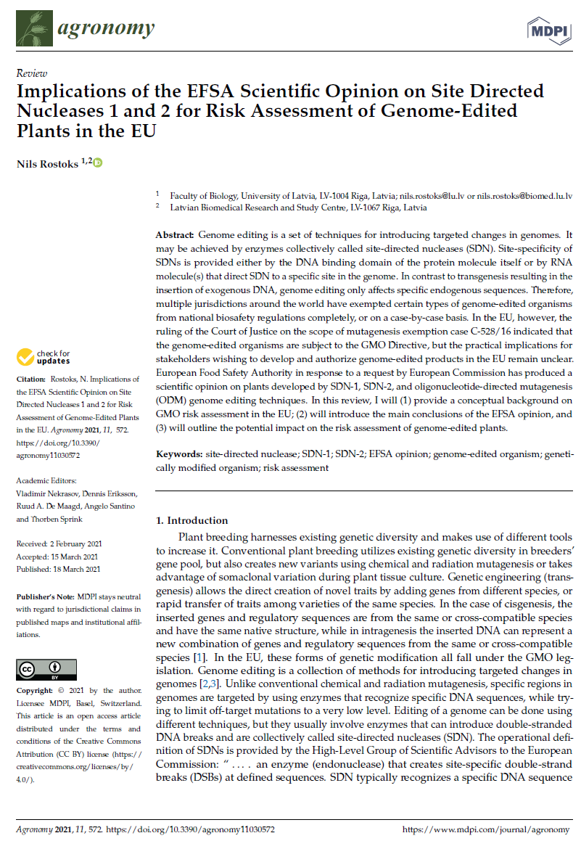


Acknowledgements

