Slide 1


Transcriptome studies in Lolium perenne under cold acclimation
Mallikarjuna Rao Kovi
Norwegian University of Life Sciences, Ås, Norway
«EditGrass4Food» kick-off meeting
Riga, 8th October, 2021
“EditGrass4Food”, ID No EEA-RESEARCH-64, Contract No EEZ/BPP/VIAA/2021/4
is financially supported by European Economic Area (EEA) grants

Slide 2
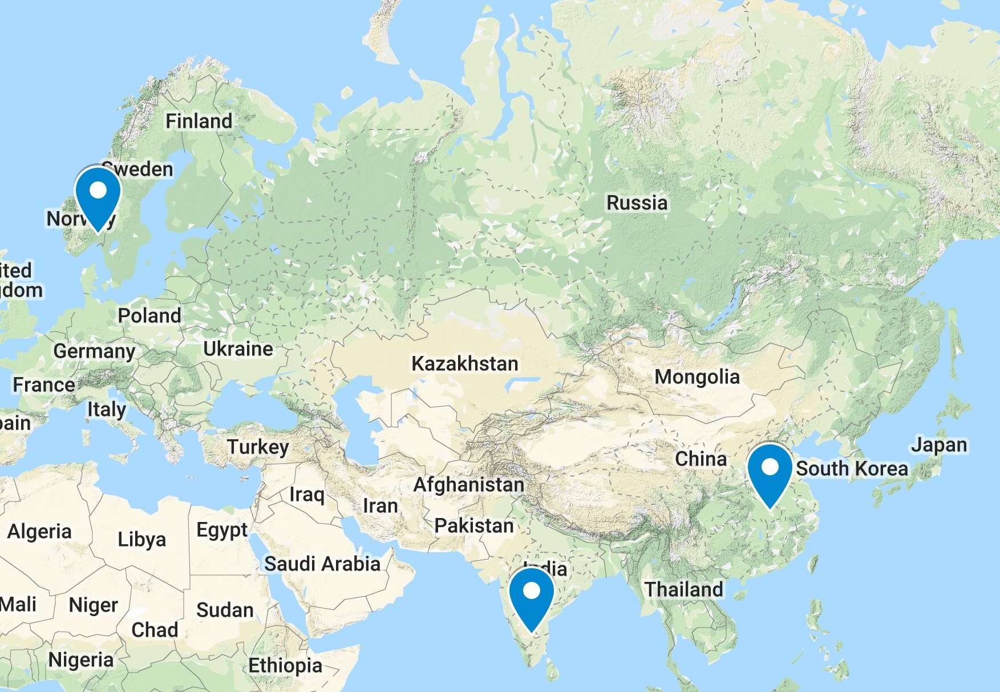
Location: NMBU, Norway
Postdoc, Researcher: Population genetics, breeding
Location: HZAU, WUHAN
Ph.D: Genetics, Breeding
Location: Bangalore University
Master : Biotechnology

Slide 3

C
Genomics Sequencing genomes
Timothy
Festuca pratensis
Enset
M.nivale
Transcriptomics
Festulolium
Lolium
Red clover
Poinsettia
Populus
Population genetics / Quantitative genetics
Red clover, Lolium
Timothy
Enset
Jatropha
Abies alba Mill.
Sweet potato
Sorghum
Proteomics
Atlantic salmon

Slide 4
C
Outline
Lolium perenne transcriptome response to cold-acclimation, deacclimation and reacclimation
Lolium perenne importance
Experimental set up
Freeze testing (LT50) results
RNAseq. pipeline
Transcriptome results
Conclusions
II. How ‘Editgrass4food’ project complement for future breeding
Lolium perenne breeding scheme
Implementing new integrated breeding technologies to accelerate genetic gain

Slide 5
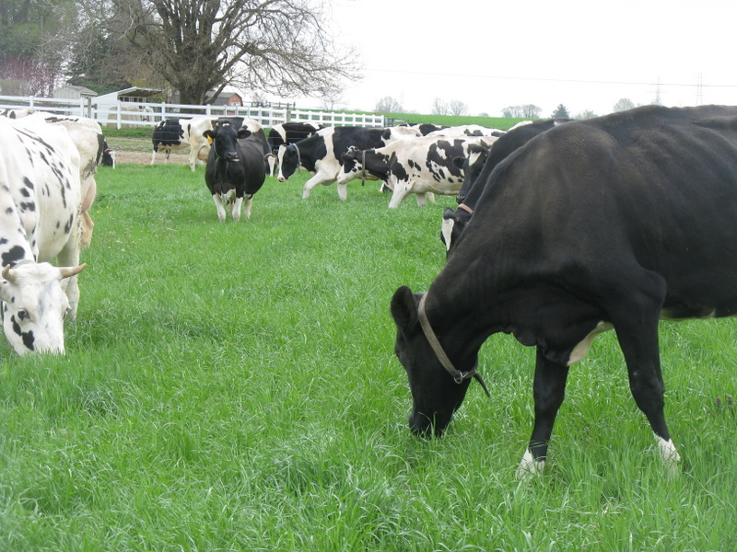
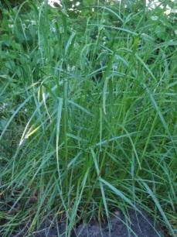
Lolium perenne
Major forage crop for pasture and silage.
High nutrition.
Widely cultivated in temperate regions.
Economic value
Climate Changes
Notes:
dominant forage grass species in Europe due to its high regrowth capacity, rapid establishment, tolerance to frequent cutting and grazing, and high nutritive value for ruminant livestock

Slide 6
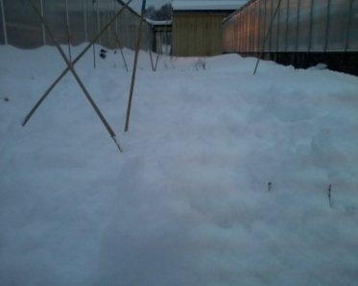
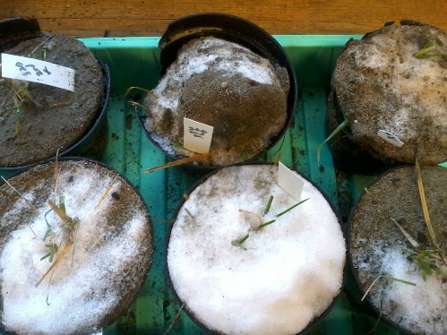
Physiological and molecular basis for cold-acclimation/de-acclimation/re-acclimation
Three important components in winter hardiness:
Cold acclimation: Development of freezing tolerance when non acclimated plants exposed to low temperatures (as in the fall)
Deacclimation: Loss of acquired freezing tolerance in response to warm temperatures
Reaccliamtion: Deacclimated plant regain some or most of the lost hardiness when exposed to low temperatures
De-acclimation resistance and re-acclimation capacity are important for protection against frost injury during late winter and early spring.
Important for adaptation of species which lack sufficient winter hardiness in perennial grasses
Aim: To study the global transcriptome changes for freezing tolerance affected by vernalization, cold acclimation, de-acclimation and re-acclimation.
Freezing tolerance varies through out the year
Notes:
-Freezing is a major environmental stress during an annual cycle of over wintering for temperate-zone perennials.
-The timing and extent of seasonal cold hardening (development of freezing tolerance in the fall) and dehardening (loss of acquired freezing tolerance in response to warm temperatures) are of critical importance for winter survival, particularly in view of the climate change, i.e., unpredictable extreme weather occurrences.
- For example, plants may acclimate inadequately if exposed to a milder fall climate and may be damaged by sudden frosts. Alternatively, they may deharden prematurely as a result midwinter warm spells and be injured by the cold that follows.
-Therefore, Efficient cold acclimation ability, high deacclimation resistance, and efficient reacclimation capacity are important components of winter survival in overwintering perennials.
-These components should be evaluated separately for a successful breeding program focused on improving winter-hardiness.

Slide 7
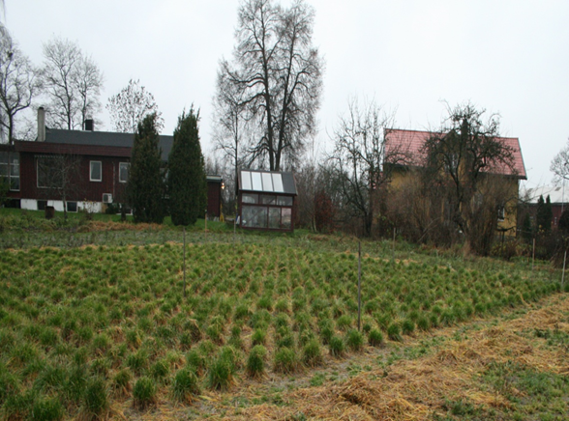
Plant Material
Two genotypes (201, 204) from the Lolium perenne cultivar Fagerlin
Genotype 201 flowered without vernalization (V-)
Genotype 204 needed vernalization (V+) to flower
Notes:
Fagerlin planted in open field to score the winter survival and flowering time. Within this cultivar, we found the two genotypes significantly different in flowering. One flowered early without vernalization, whereas other required vernalization.

Slide 8

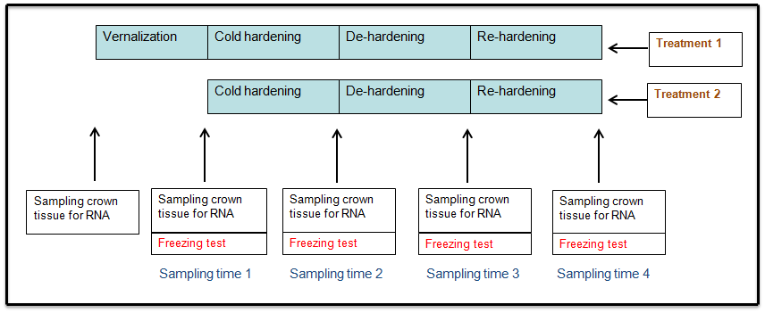
Outline of Gene expression studies for cold hardiness in Lolium perenne genotypes 201(V-) and 204 (V+) under two treatments (vernalization and non-vernalization)
Treatment 1: Vernalization; 10 weeks at +6 ºC
Treatment 2: No vernalization, 10 weeks at +15 ºC
Cold hardening: 4 weeks at +2 ºC
De-hardening: 8 days at +9 ºC
Re-hardening: 2 weeks at +2 ºC
Freezing tests: -4 ºC to -20 ºC, detecting LT₅₀

Slide 9
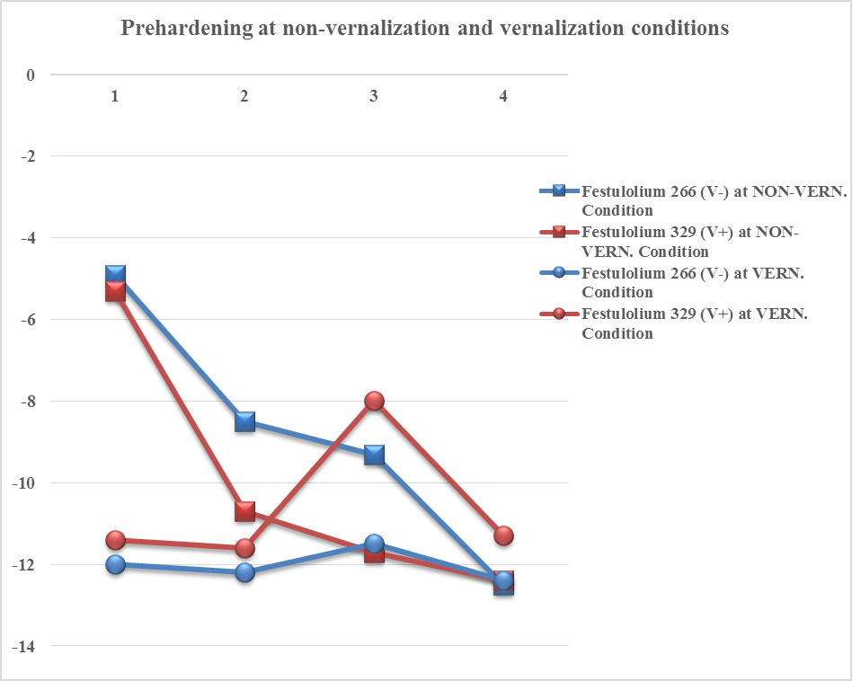
Freeze testing results of Lolium genotypes differed in vernalization requirements
Lolium 201 (V-) at NON-VERN.
Condition
Lolium 204 (V+) at NON-VERN.
Condition
Lolium 201 (V-) at VERN.
Condition
Lolium 204(V+) at VERN.
Condition
LT₅₀ (ºC)
Hardening
De-hardening
Re-hardening
Cold acclmation
De-acclimaton
Re-acclimation
Notes:
In non-vernalized plants (pretreatment at 15c) there is no clear pattern of dehardening and rehardening when compared to vernalized plants.
The LT50 results showed that vernalization at +6c led to higher frost tolerance than pretreatment at +15c.
V+ genotype vernalized at +6c showed the largest capacity to reharden (3-6c), thus showing significant difference between these two genotypes possibly linked to vernalization requirements.

Slide 10
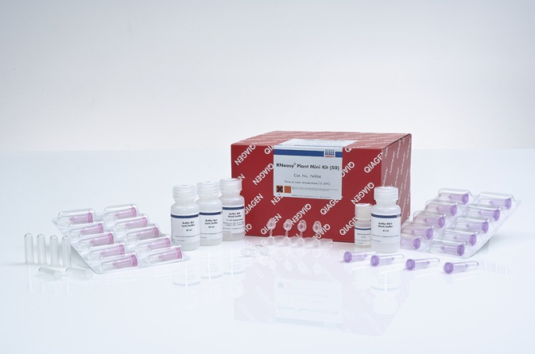
RNA extraction, quality check, sequencing, data analysis
54 samples (crown tissues)
Qiagen plant RNA extraction kit
Nanodrop
Server
Illumina Hiseq 2000
Bio-analyzer

Slide 11
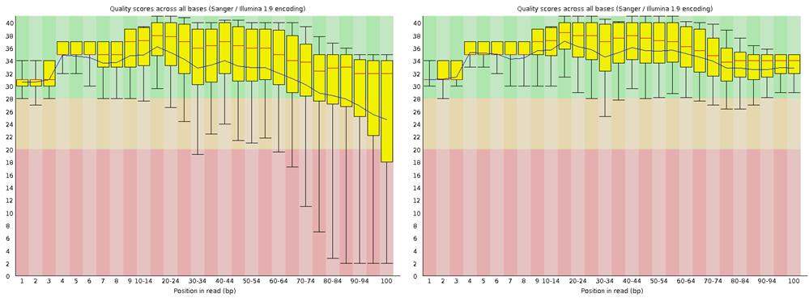
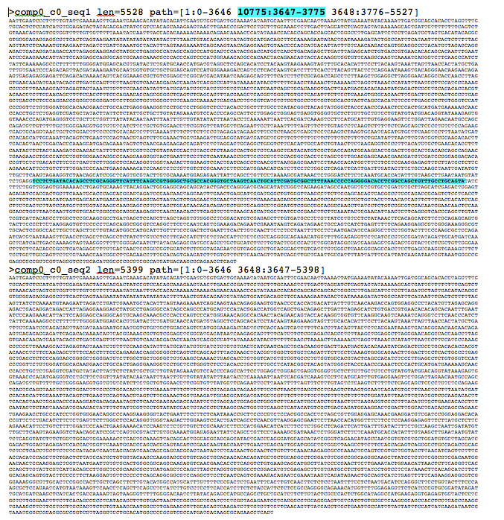
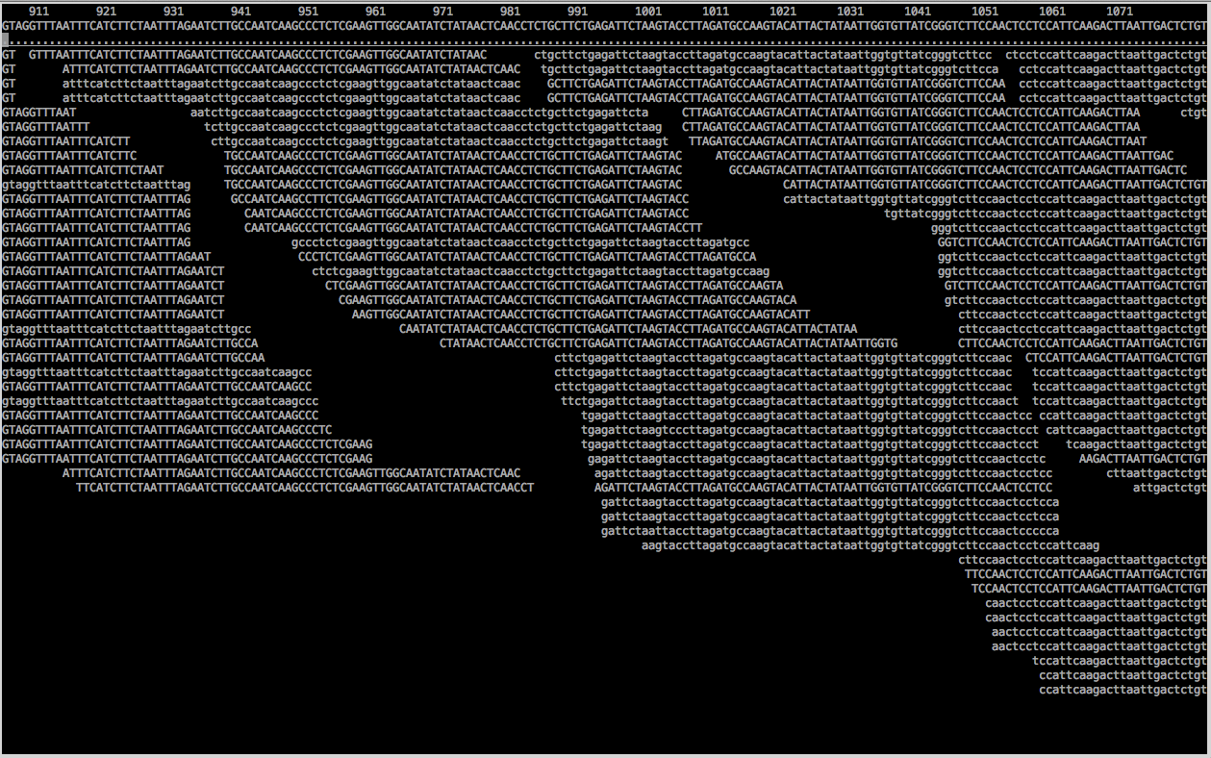
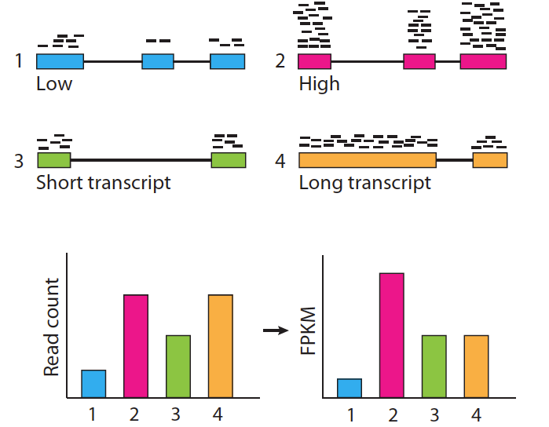
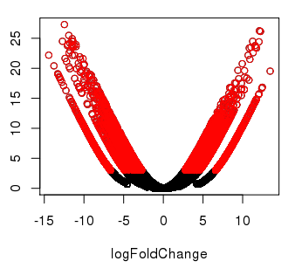
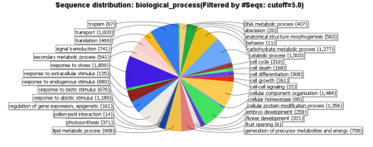
RNA seq. analysis pipeline
Millions of reads
Quality control
FastQC
@DJDP4KN1:149:D1G47ACXX:1:1101:1745:2247 1:N:0:CGATGT
CCGATCTATTTGGNTCATATGCAGAGGCATCTTGTGCTGCCCTTGTTGTTG
+
@@CFDDDDFHGHH#2AEFHIJJGGIIFJCGHJIGIIIIJ9DGCDDFHGIHG
@DJDP4KN1:149:D1G47ACXX:1:1101:6683:2245 1:N:0:CGATGT
CACAGATGCATTTNCAACCTCTTCCTTTTCCTCTTCAACTTGTGCTGCTAC
+
<8=??AAD>ADDD#22CEACCEBCFECEFIICCEC<4?D@@D?DCEEEII<
@DJDP4KN1:149:D1G47ACXX:1:1101:8087:2248 1:N:0:CGATGT
AAGTCAAAAGGAGAGAACAAGACGGAGGAGAATCGAATCAAATCGAATAAC
+
@
Trimmed reads
Denovo assembly by trinity
Bowtie
Align reads to transcript assembly
RSEM
Transcript abundance
edgeR
DE genes
Normalization
Gene Clusters
Mapping, Annotation
Blast
Blast2go

Slide 12
Trinity de novo assembly output
Genotype | 201 (V-) | 204 (V+)
No. of transcripts | 272,960 | 247,352
N50(bp) | 1,643 | 1556
Max length (bp) | 10,065 | 11,178
Total no. of reads | 296 million | 242 million
Notes:
Scaffold/contig length at which you have covered 50% of total assembly length- N50
Biased in recent papers

Slide 13
De novo assembly validation by CEGMA analysis
Out of 248 CEGs¹ | Festulolium_266 (V-) | Festulolium_329 (V+)
% of fully represented | 97.58 | 97.98
% of at least partially represented | 100.00 | 100.00
Average number of orthologs per CEG | 3.83 | 3.93
% of detected CEGs with more than 1 ortholog | 98.76 | 99.18
¹ CEGs: Core Eukaryotic Genes
Notes:
Core eukaryotic genes mapping approach

Slide 14
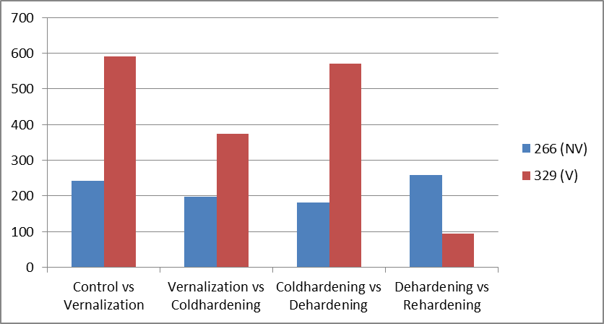
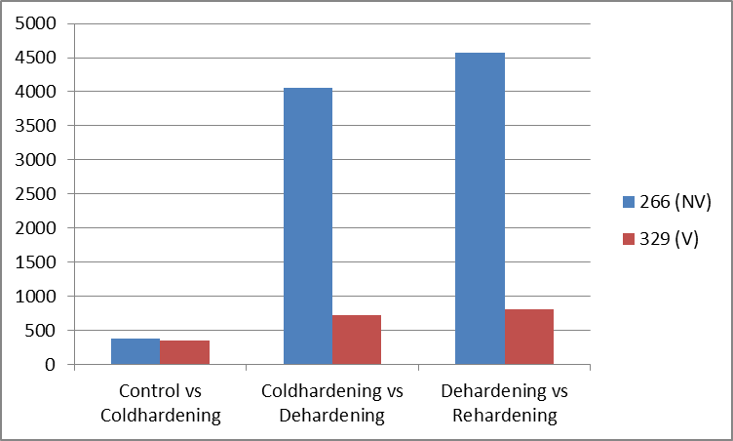
Differentially expressed transcripts in Lolium 201 (V-) and 204 (V+)
TREATMENT 1 (V)
TREATMENT 2 (NV)
201 (V-)
204 (V+)
201 (V-)
204 (V+)
Notes:
Interesting pattern is to see the number of DE transcripts substantially decreased in both genotypes when placed in different vernalizaion treatments (204 (V+) transcripts decreased while treated at no vernalization requirement treatment and viceversa. This shows the influence of vernalization on the cold acclimation. All these transcripts were performed blast

Slide 15
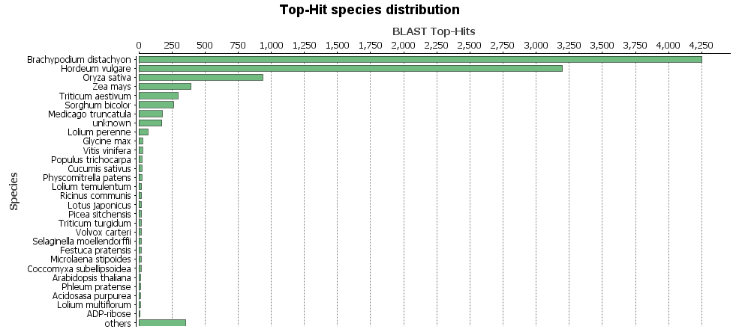
BLAST

Slide 16
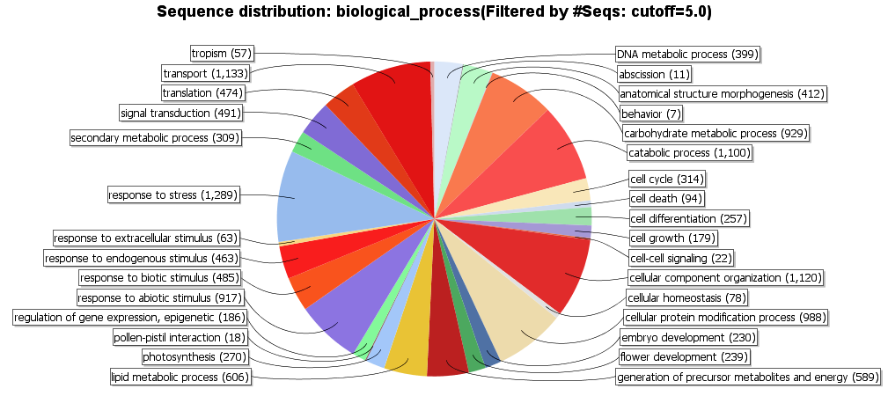
Gene ontology

Slide 17
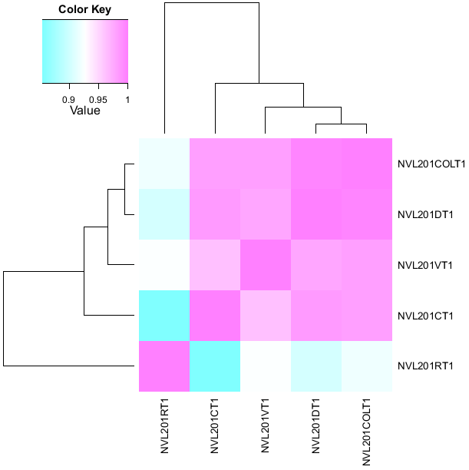
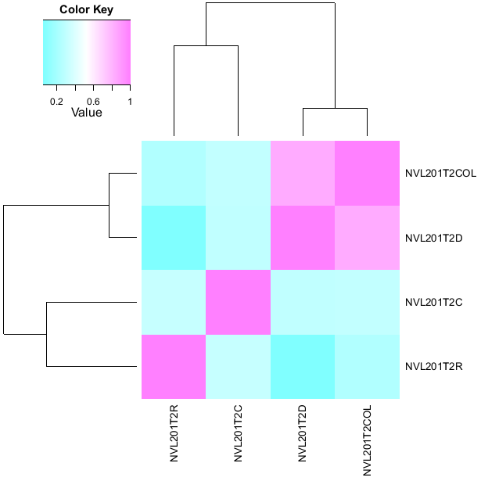
Clustering results of Lolium 201 (V-) in two treatments

Slide 18
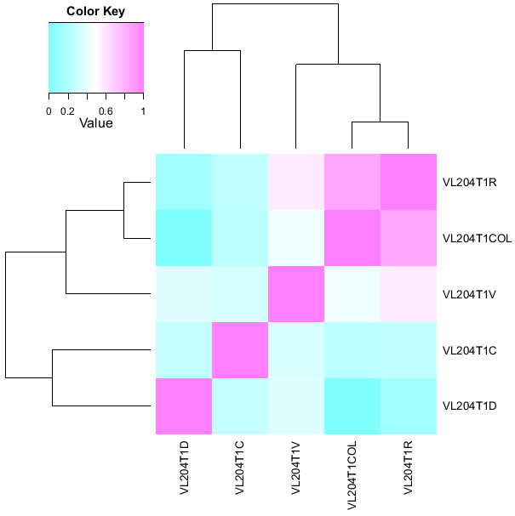
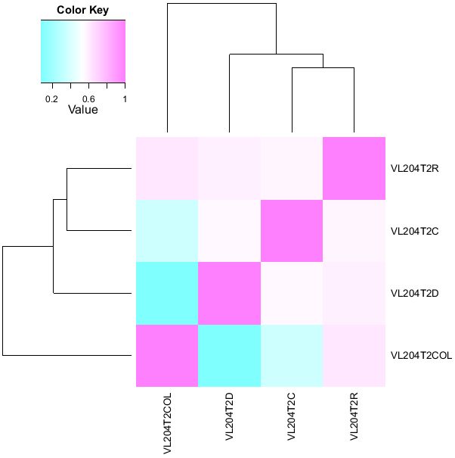
Clustering results of Lolium 204 (V+) in two treatments

Slide 19
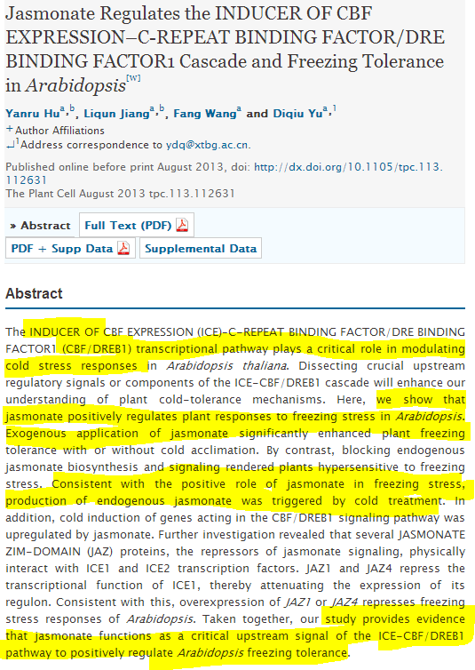
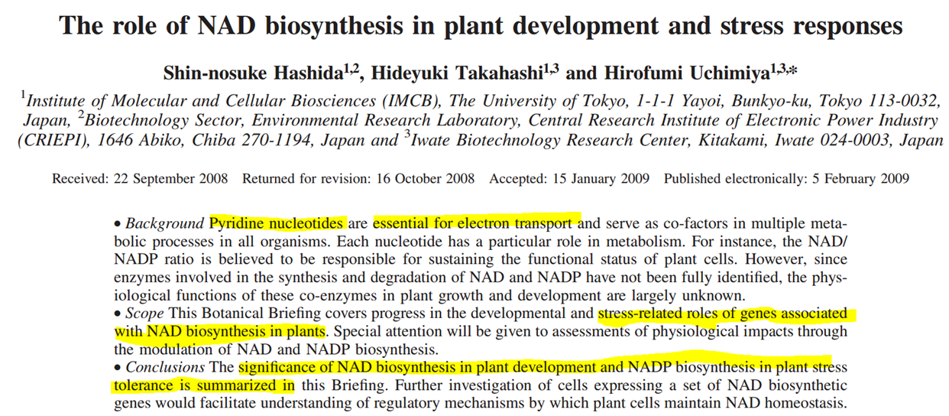
Enrichment Analysis (Fischers exact test)
Comparision between 201 (V-) and 204 (V+) genotypes
201 (V-)
204 (V+)

Slide 20
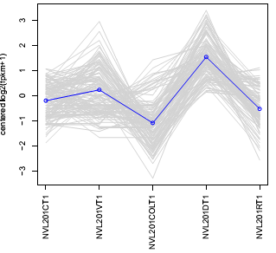
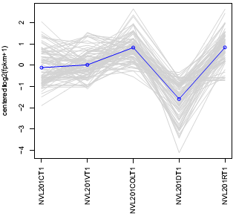
Subclusters for Lolium 201(V-) in vernalization treatment
Photosnthesis related genes encoding D2 subunits of PSII complex
AP2/EREB transcription factors
Arabinogalactan
Chlorophyll a-b binding protein
Calmodulin binding protein
Calreticulin2
Zinc finger (C2H2) family proteins
Glutathione-s-transferase
homeobox.-leucine zipper protein
Pyroline 5 carboxylate synthase

Slide 21
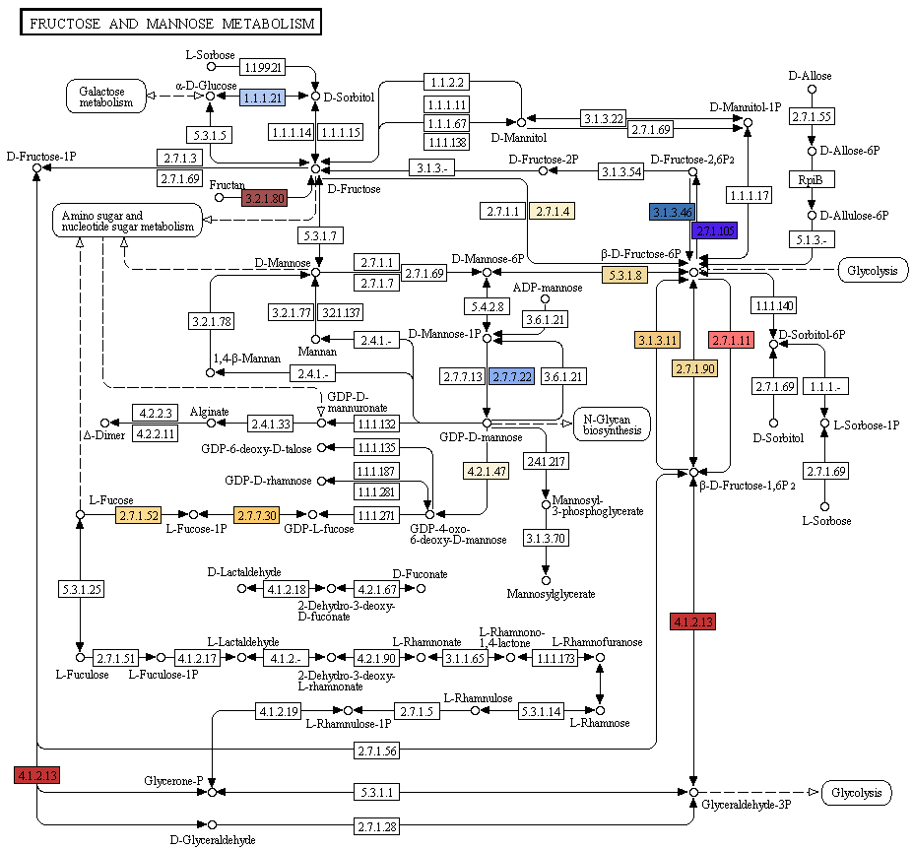
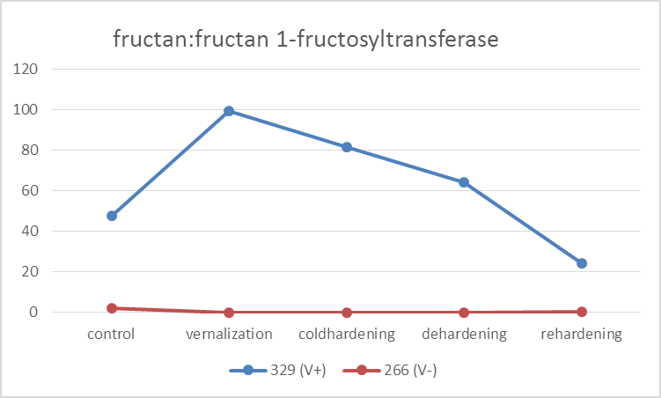
Genes involved in fructose metabolic pathway
201 (V-)
204( V+)

Slide 22
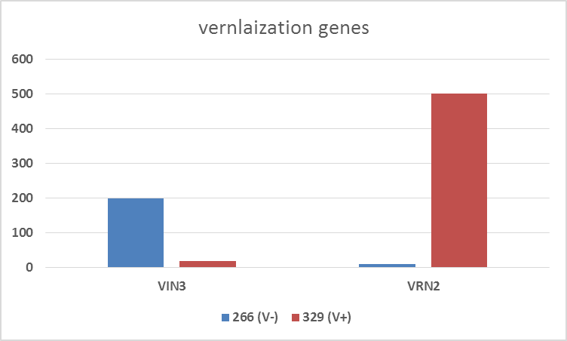
Is VIN3 and VRN2 delaying flowering in genotype 204 (V+) ?
VIN3 is a vernalization insensitive gene required for repressing FLC during cold
VRN2, a homologous gene of the OsGHD7 gene, is highly expressed in 204 (V+) which might delay the flowering
FPKM
201 (V-)
204 (V+)
Notes:
VRN2 function therefore stably maintains FLC repression after a cold treatment, serving as a mehanism for cellular memory of vernalization . Vrn2 gene mediates vernalization and encodes a nuclear localized zinc finger protein with similarity to polycomb group proteins of plants.
Reduction of RNA level of vrn2 by rnai accelerated the flowering time of transgenic winter wheats plants.

Slide 23
Conclusions
RNA seq. approach is highly instrumental in profiling the global expression of genes at vernalization, cold hardening, dehardening and rehardening
Detected genes related to vernalization, stress responsive involved in cold-response, cold sensing, signal transduction and osmo-sensing
VIN3 and VRN2 might be playing a crucial role in delaying flowering in 204 (V+) genotype
Some of the genes identified for cold acclimation will be tested in editgrass4food project

Slide 24
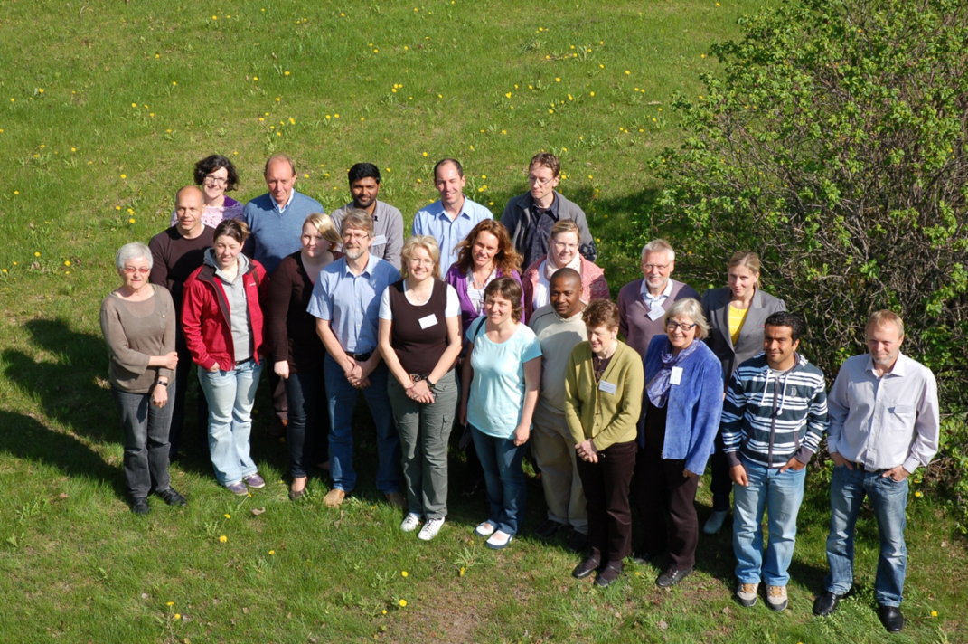
ACKNOWLEDGEMENTS
NORWAY DENMARK
Norwegian University of Life Sciences Aarhus University
Prof. Odd Arne Rognli Dr. Torben Asp
Åshild Ergon Dr. Stephen Byrne
NIBIO
Dr. Liv Østrem
Dr. Mats Høglind
Graminor
Dr. Petter Marum
Dr. Arild Larsen
Funding:
VARCLIM project: Norwegian Research Council
NOFOCGRAN travel grant

Slide 25
How ‘Editgrass4food’ project complement for future breeding ?

Slide 26
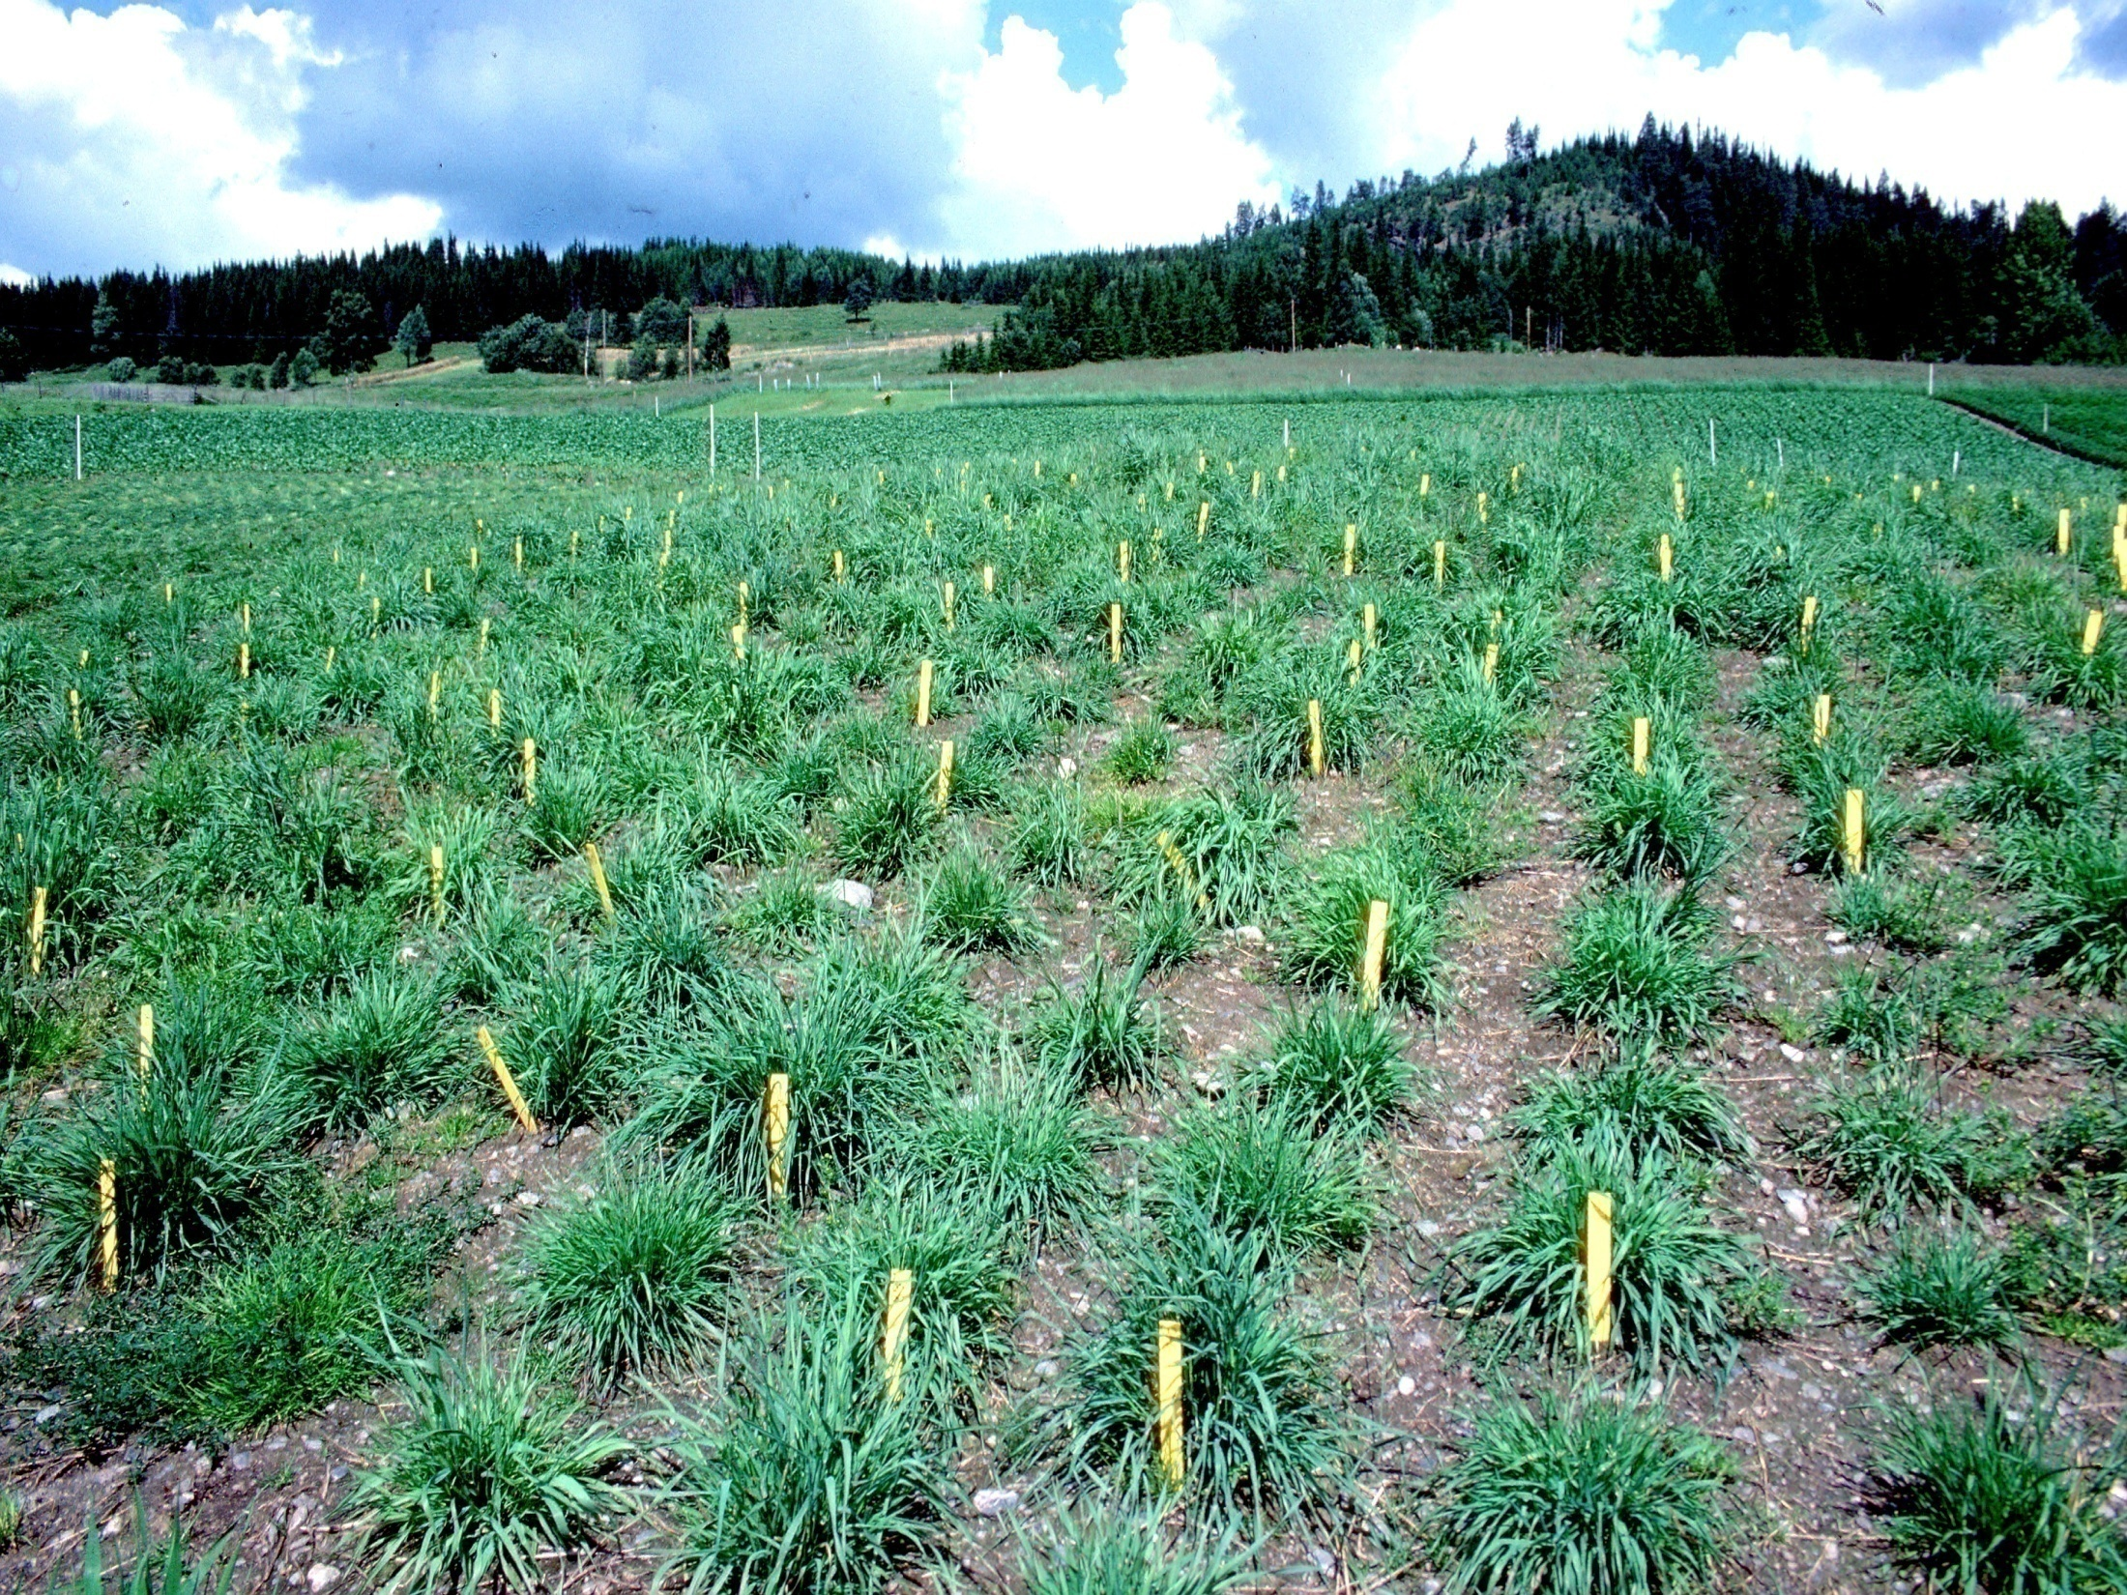
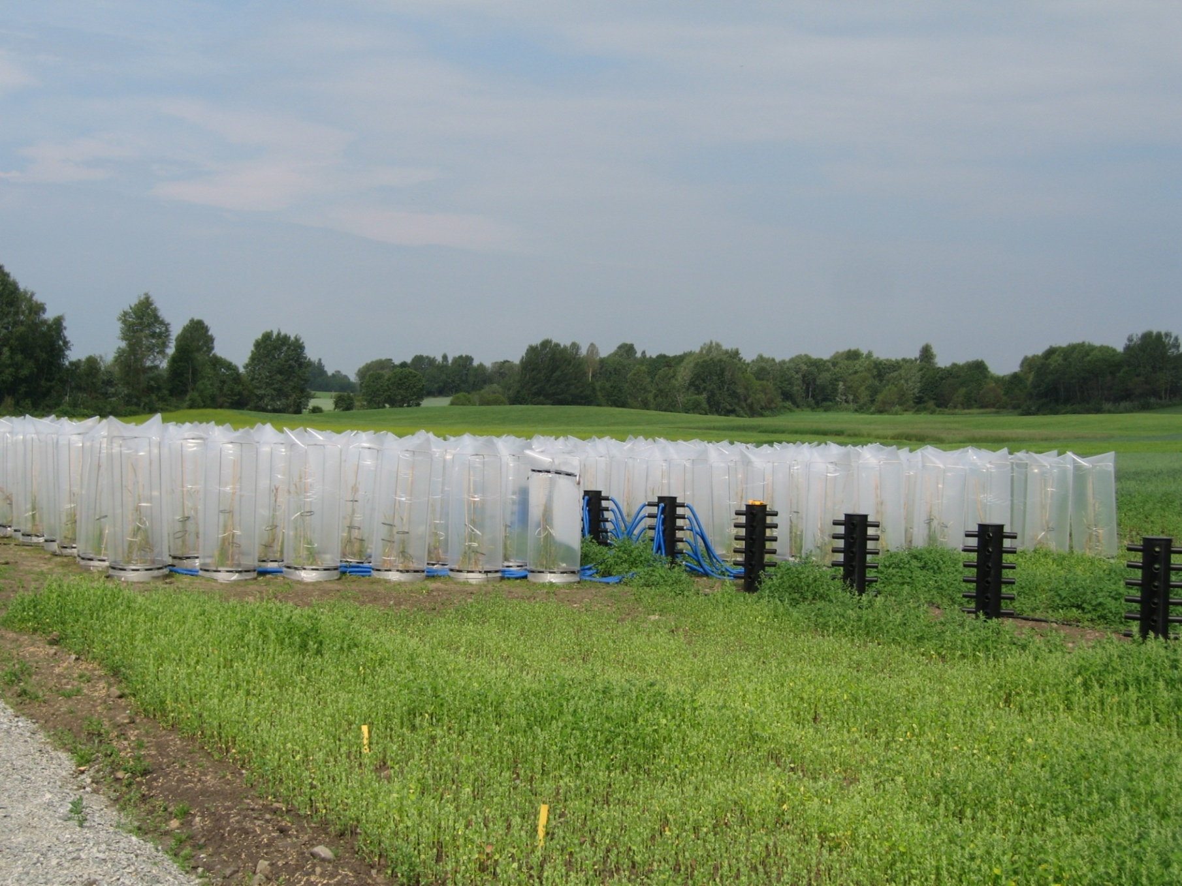
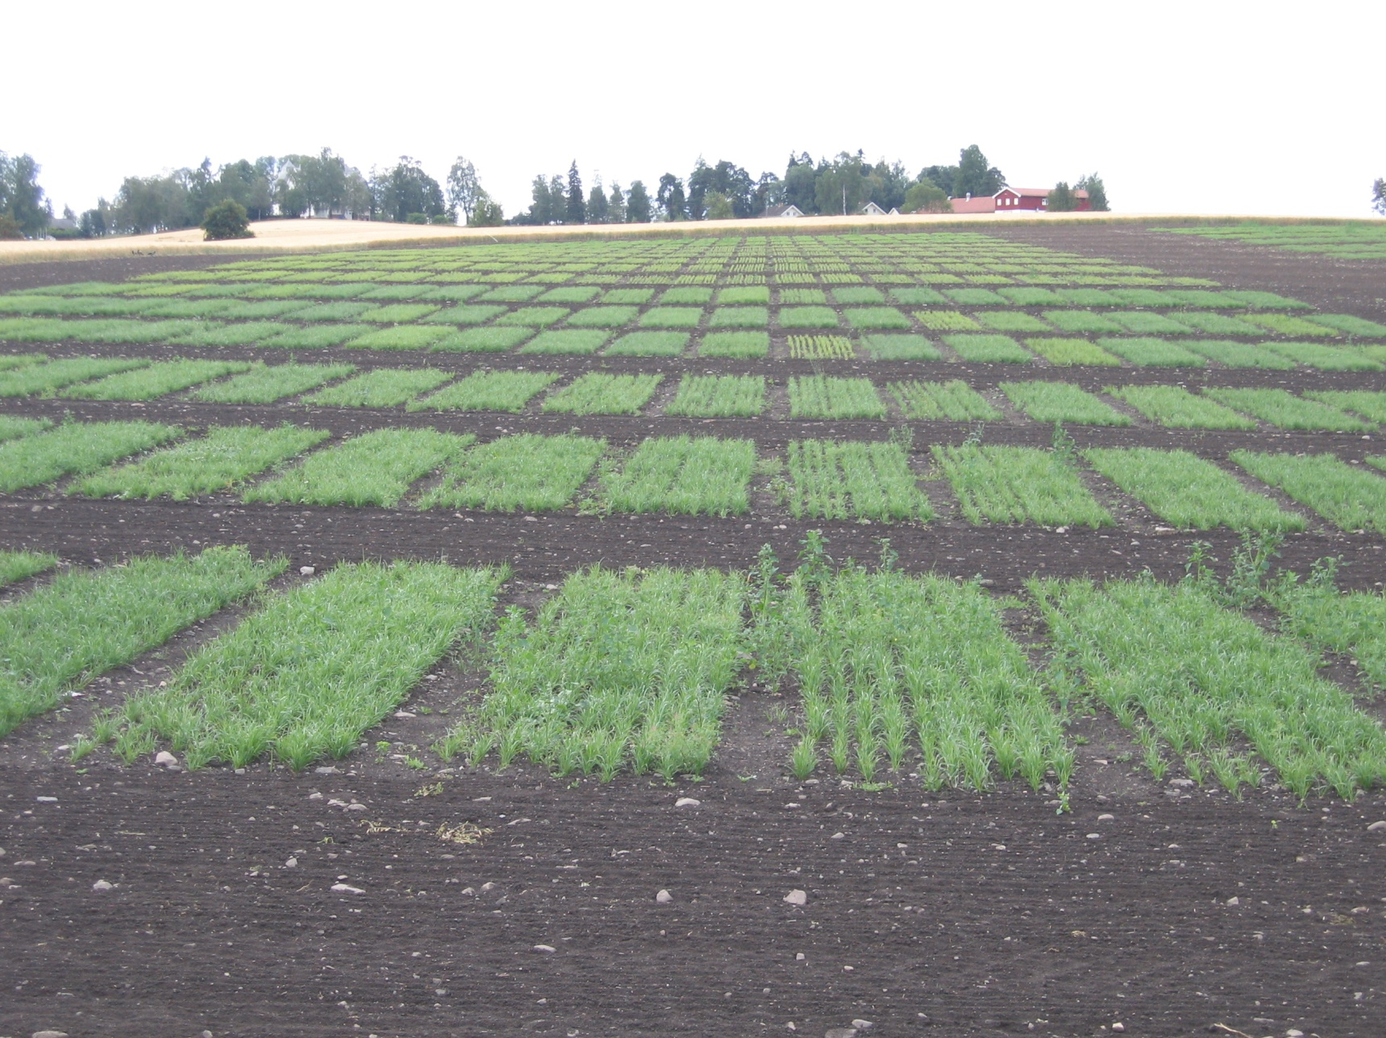
Breeding program
Clones
År 1
År 2
FS1/HS1
År 3
År 4
FS2/HS2
År 5
År 6
Progeny testing
År 7
År 8
År 9
SYN 1
År 10
År 11
År 12
SYN 2
År 13
År 14
Candivar test
/SYN 3
År 15
År 16
Breeders seed/SYN 4
År 17
År 18
Official
variety
testing
Seed Test
År 19
År 20

Slide 27
Integrated breeding platforms
Xu et al. 2019, Plant Communications

Slide 28
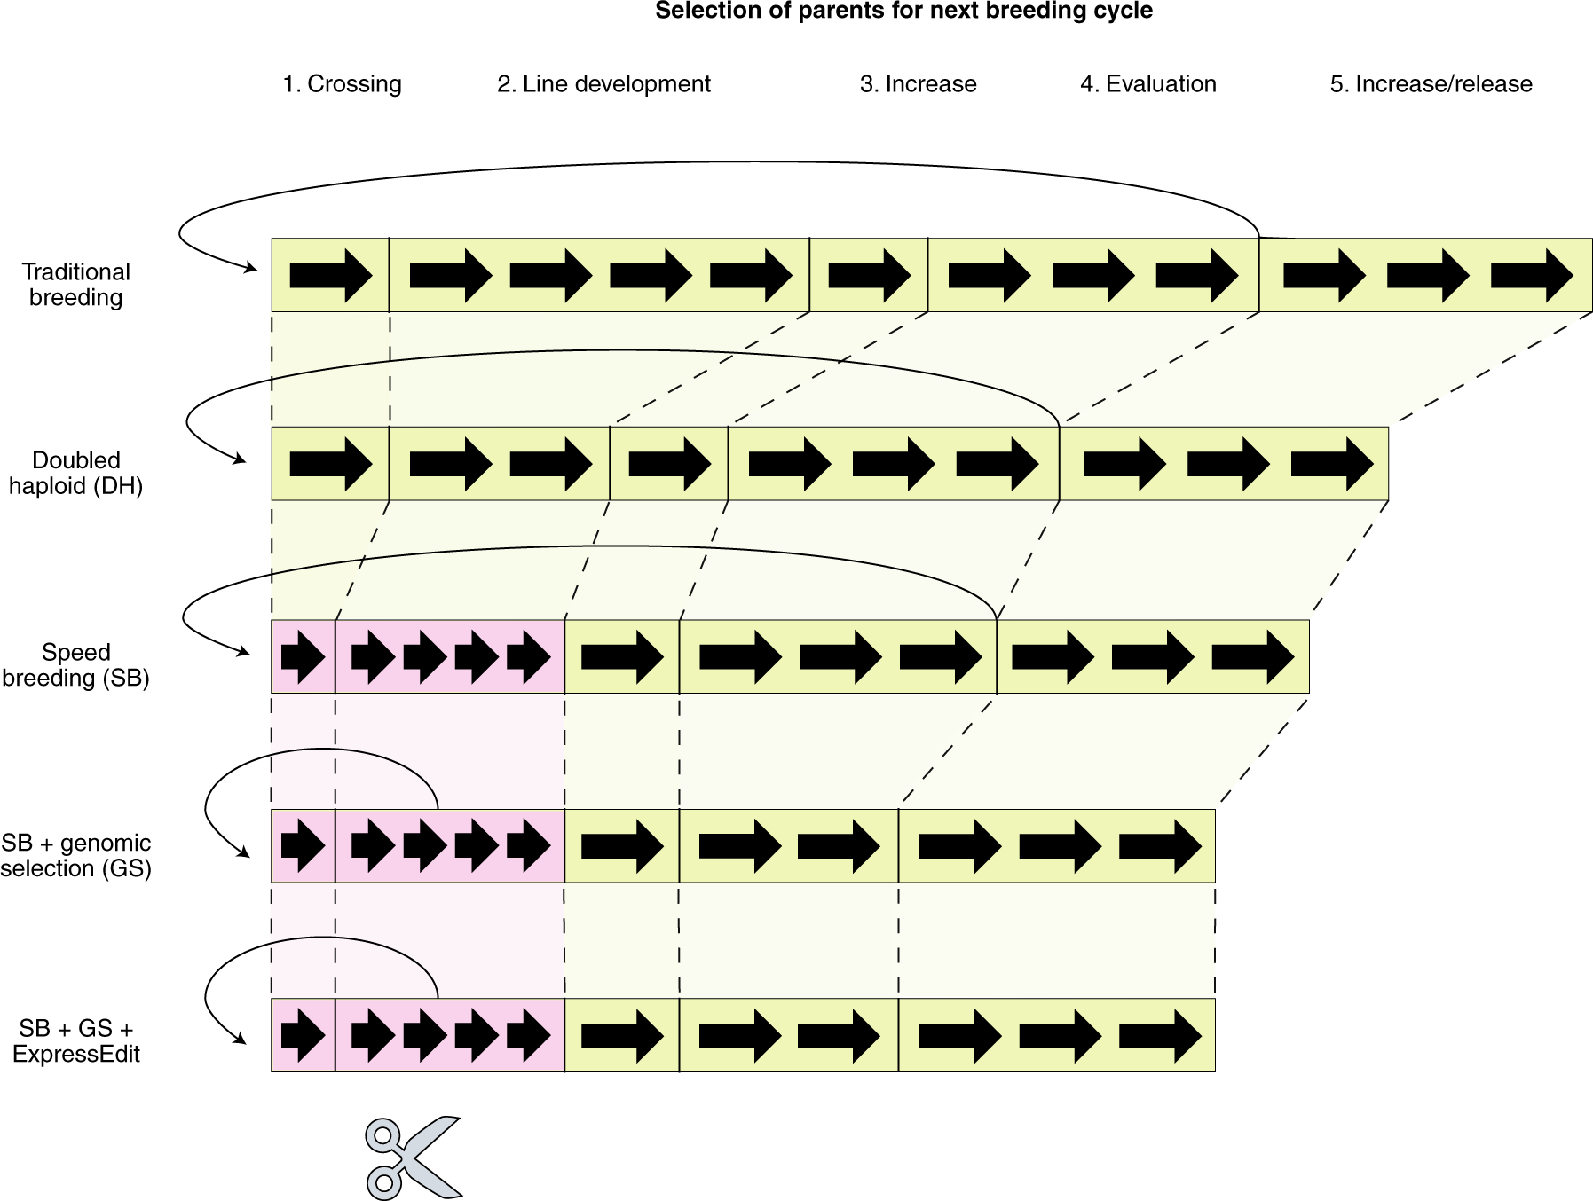
GS+SB+GE reduce breeding cycles
Hickey et al. 2019, Nat.Biotech
Notes:
Visual representation of breeding strategies and comparison of cycle length for traditional breeding versus progressive
strategies that exploit doubled haploid (DH), speed breeding (SB), genomic selection (GS) and ExpressEdit (indicated by scissors). Pink shading indicates
steps that are performed under speed breeding conditions while green shading indicates steps performed under conventional conditions. Block arrows
indicate a single generation. The curved arrows indicate steps in the breeding pipeline where the best lines identified by field evaluation or genomic
selection are used as parents to make new crosses. Example provided for an inbred crop.

Slide 29
Editgrass4food will play cruclal role for accelarting future integrated breeding technologies in forage grasses

Slide 30


