Slide 1


EditGrass4Food WP3 (Taltech):
Progress
Ferenz Sustek Sánchez
Institute of Chemistry and Biotechnology
Tallinn University of Technology

Slide 2
In-vitro tissue culture
All the lines from our collection (plants from Kristina) have been able to generate calli.
We have calli from 2 out of 3 “drought sensitive” lines (3575 & 3776).
Propagation of tillers: tricky due to contamination.
  Fungicide pre-treatment: reduced contamination and no effect on tiller growth.
  Fungicide in media: still figuring out the concentration. The minimum tested (Cycloheximide 10 mg/L) slows down fungi growth. More tillers can be “rescued”.

Slide 3
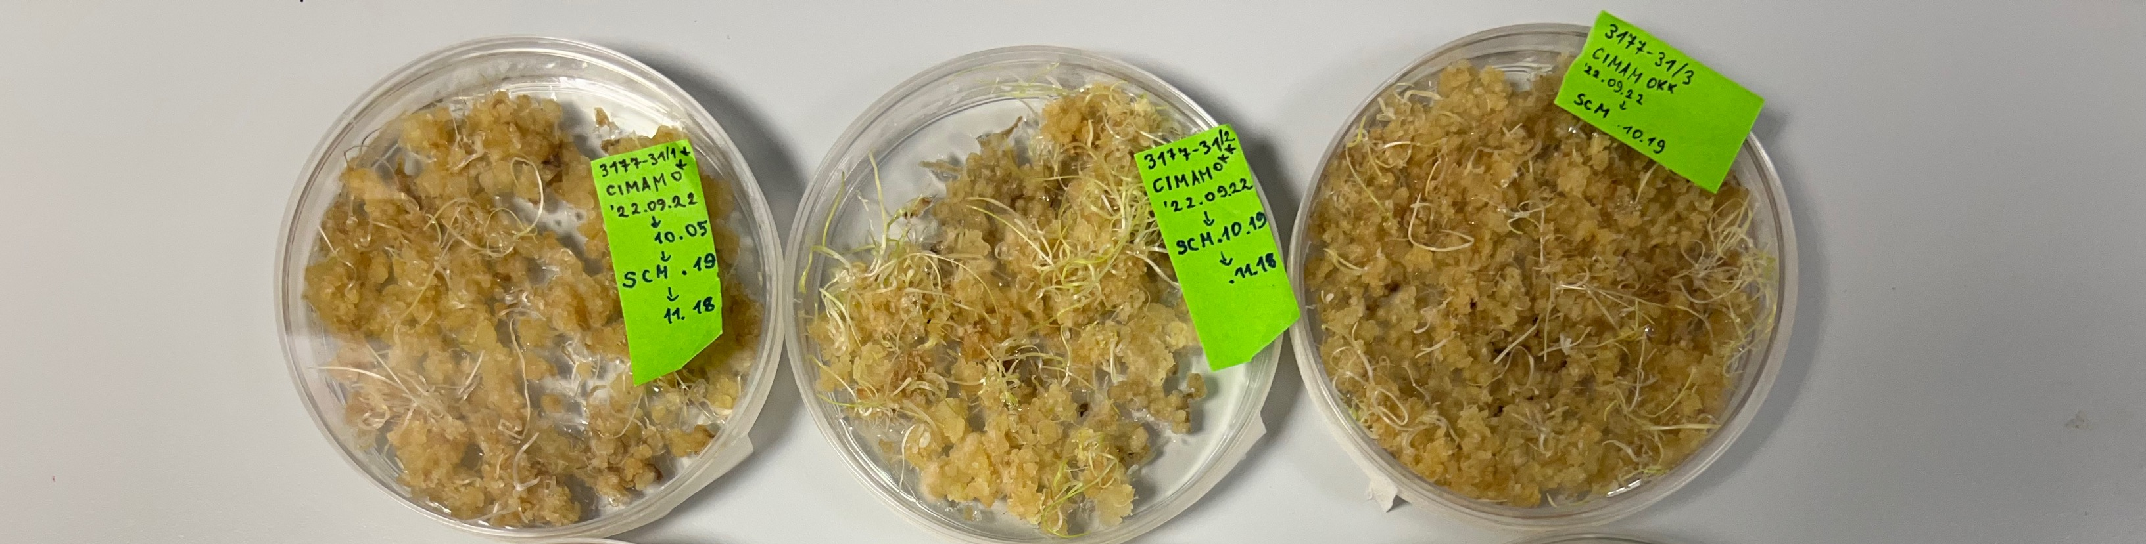
Calli transformation
Co-cultivation with Agrobacterium tumefaciens
Test using strain (EHA105) containing a plasmid from SK with ZsGreen
Adjust and adapt protocol from TEAGASC

Slide 4
Design of gRNAs targeting (all) Candidate genes
Using Danish genome for off-targets
Vectors assembly for first tests
  Modular plasmids from Voytas lab (Gateway assembly)
    pMOD_A1110: TaCas9 under promoter ZmUbi
    pMOD_B2303: CmYLCV promoter. Cassette for cloning multiple gRNA spacers with tRNA spacers.
    pMOD_C0000:empty vector needed for correct assembly
    pTRANS: destination vector from SK. It has GRF-GIF and ZsGreen
Notes:
Cestrum yellow leaf curling virus
https://blog.addgene.org/back-to-bacteria-crispr-grna-multiplexing-using-trnas

Slide 5

Protoplasts experiments
Isolation methods
Cutting leaves
Blending leaves
Different conditions
Mannitol pretreatment
Enzyme concentrations
Vacuum infiltration
Incubation duration

Slide 6
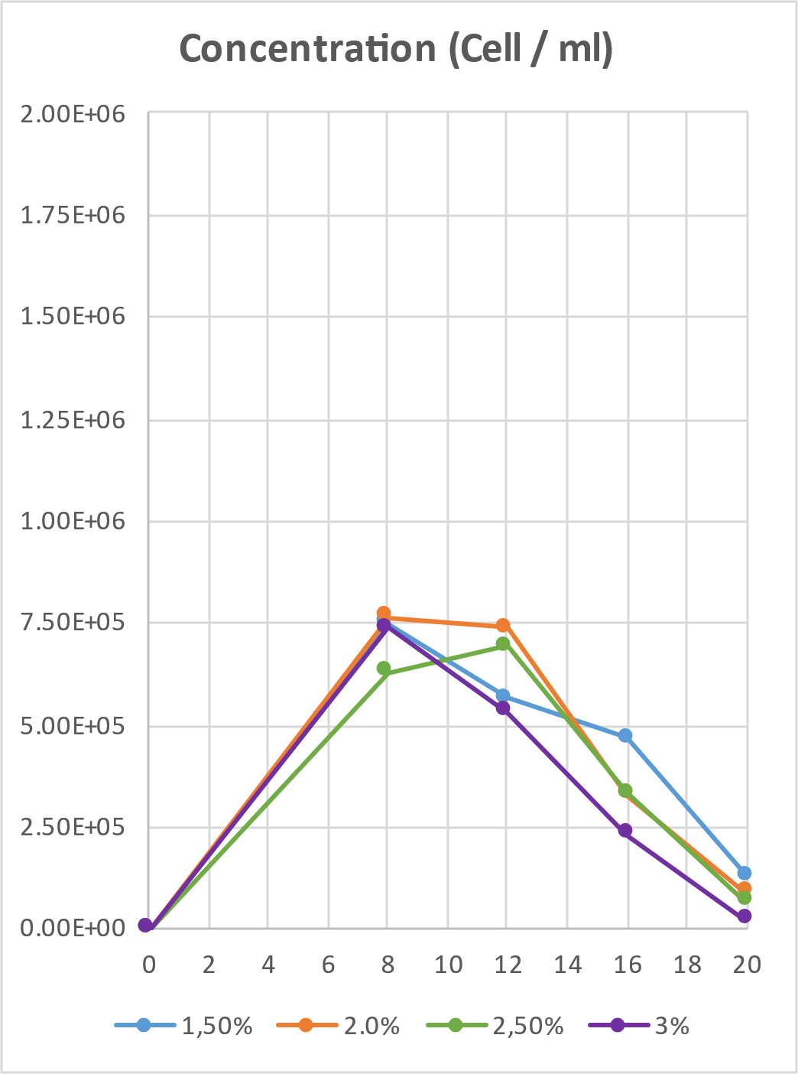
Cellulase concentration
Experiment repeated 4 times.
The 2% treatment seems to yield the highest amount of protoplasts.
More than 12 hours of incubation starts degrading the protoplasts.
No much difference between 8 and 12 hours.

Slide 7
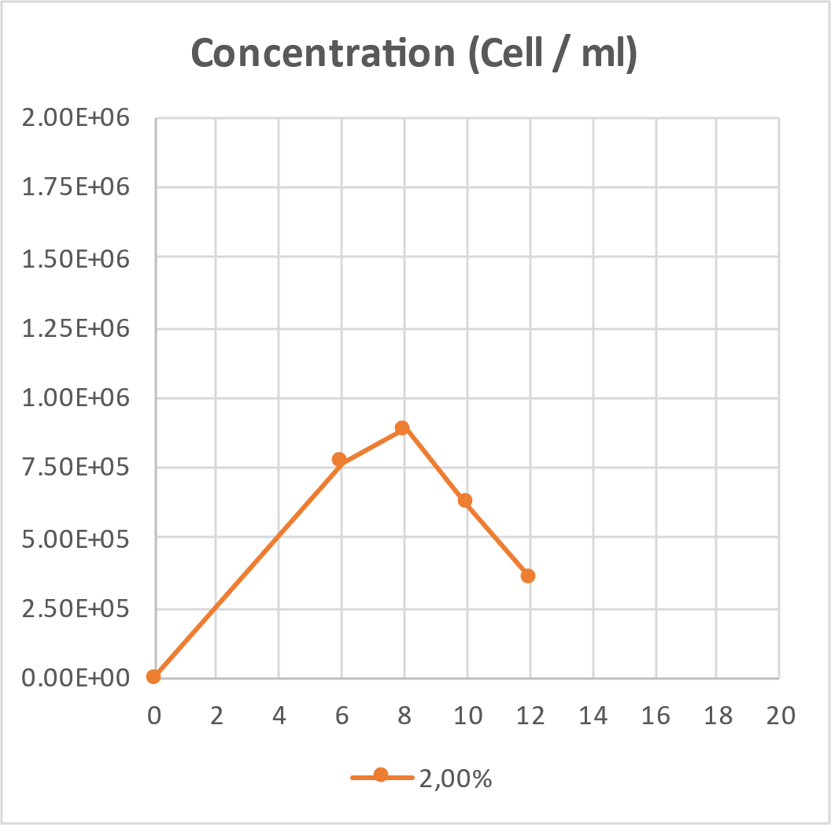
Cellulase concentration
Experiment repeated 4 times.
We checked the 2% cellulase concentration
8 hours of incubation seems the best treatment.
No more than 8 hours will be used for the following experiments.

Slide 8
Mannitol pre-treatment
3 out of 4 experiments done.
The 0.5M treatment seems to yield the highest amount of protoplasts

Slide 9

Visit to Lithuania
Isolation of RNA from “freezing experiments” samples.
Measurement of
  stomatal conductance
  Fv/Fm (ratio representing maximum quantum yield of PSII).

Slide 10



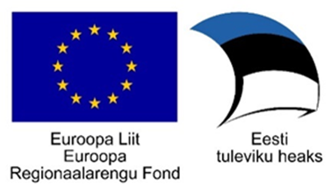
Cecilia Sarmiento
Merike Sõmera
Lenne Nigul
Signe Nöu
Erki Eelmets
Olav Kasterpalu

