Slide 1
U of Latvia team progress report of WP3 for EditGrass4Food meeting 30.03.2023.
Anete Borodušķe

Slide 2
Work in two directions
plasmid constructs
protoplast cultures

Slide 3
Preparing plasmid constructs for EditGrass
Target genes based on the literature
HvCBP20 – a negative regulator of cuticular wax formation in barley
AtCBP60G – a positive regulator of drought tolerance, crosstalk between SA and ABA signaling in A. thaliana
Tried to sequence also- dehydrins, HKT1, HKT2, HKT3, NHX, GolS, GolS2 – unsuccessfully, will clone alleles to sequence
HvCBP20 – one homologous genomic seq in L. perenne

Slide 4
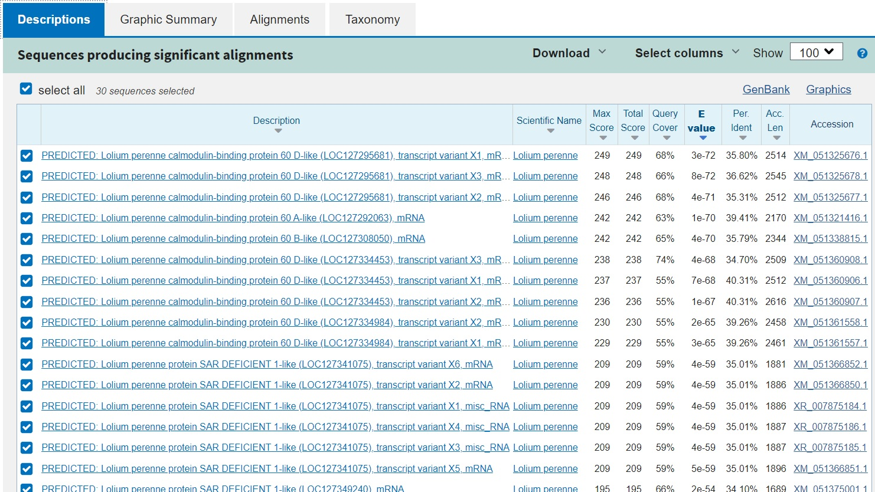
AtCBP60G – many homologues, selected 3 with the highest homology
Sequenced ~ 1kb from target genes from the project genotypes and from cv. ‘Veja’ for gRNA validation in protoplasts.

Slide 5
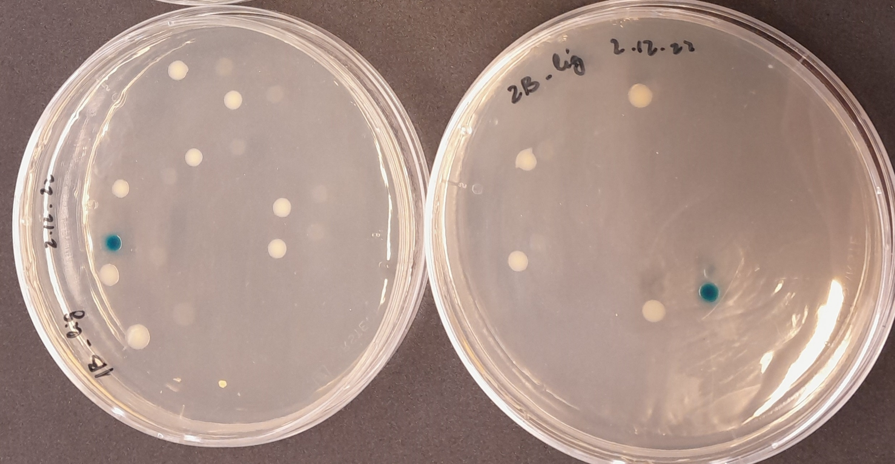
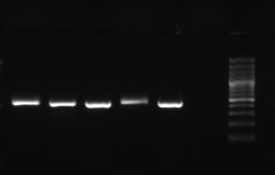
Designed gRNA
Targeting 1st exon
Avoiding sites polymorphic among project genotypes
CBP20
5 gRNA
CBP60G
3 gRNA – one for each locus, more will be designed
Plasmid constructs with designed gRNAs
Blue/white selection
PCR with gRNA oligo+plasmid oligo
confirmed by sequencing

Slide 6
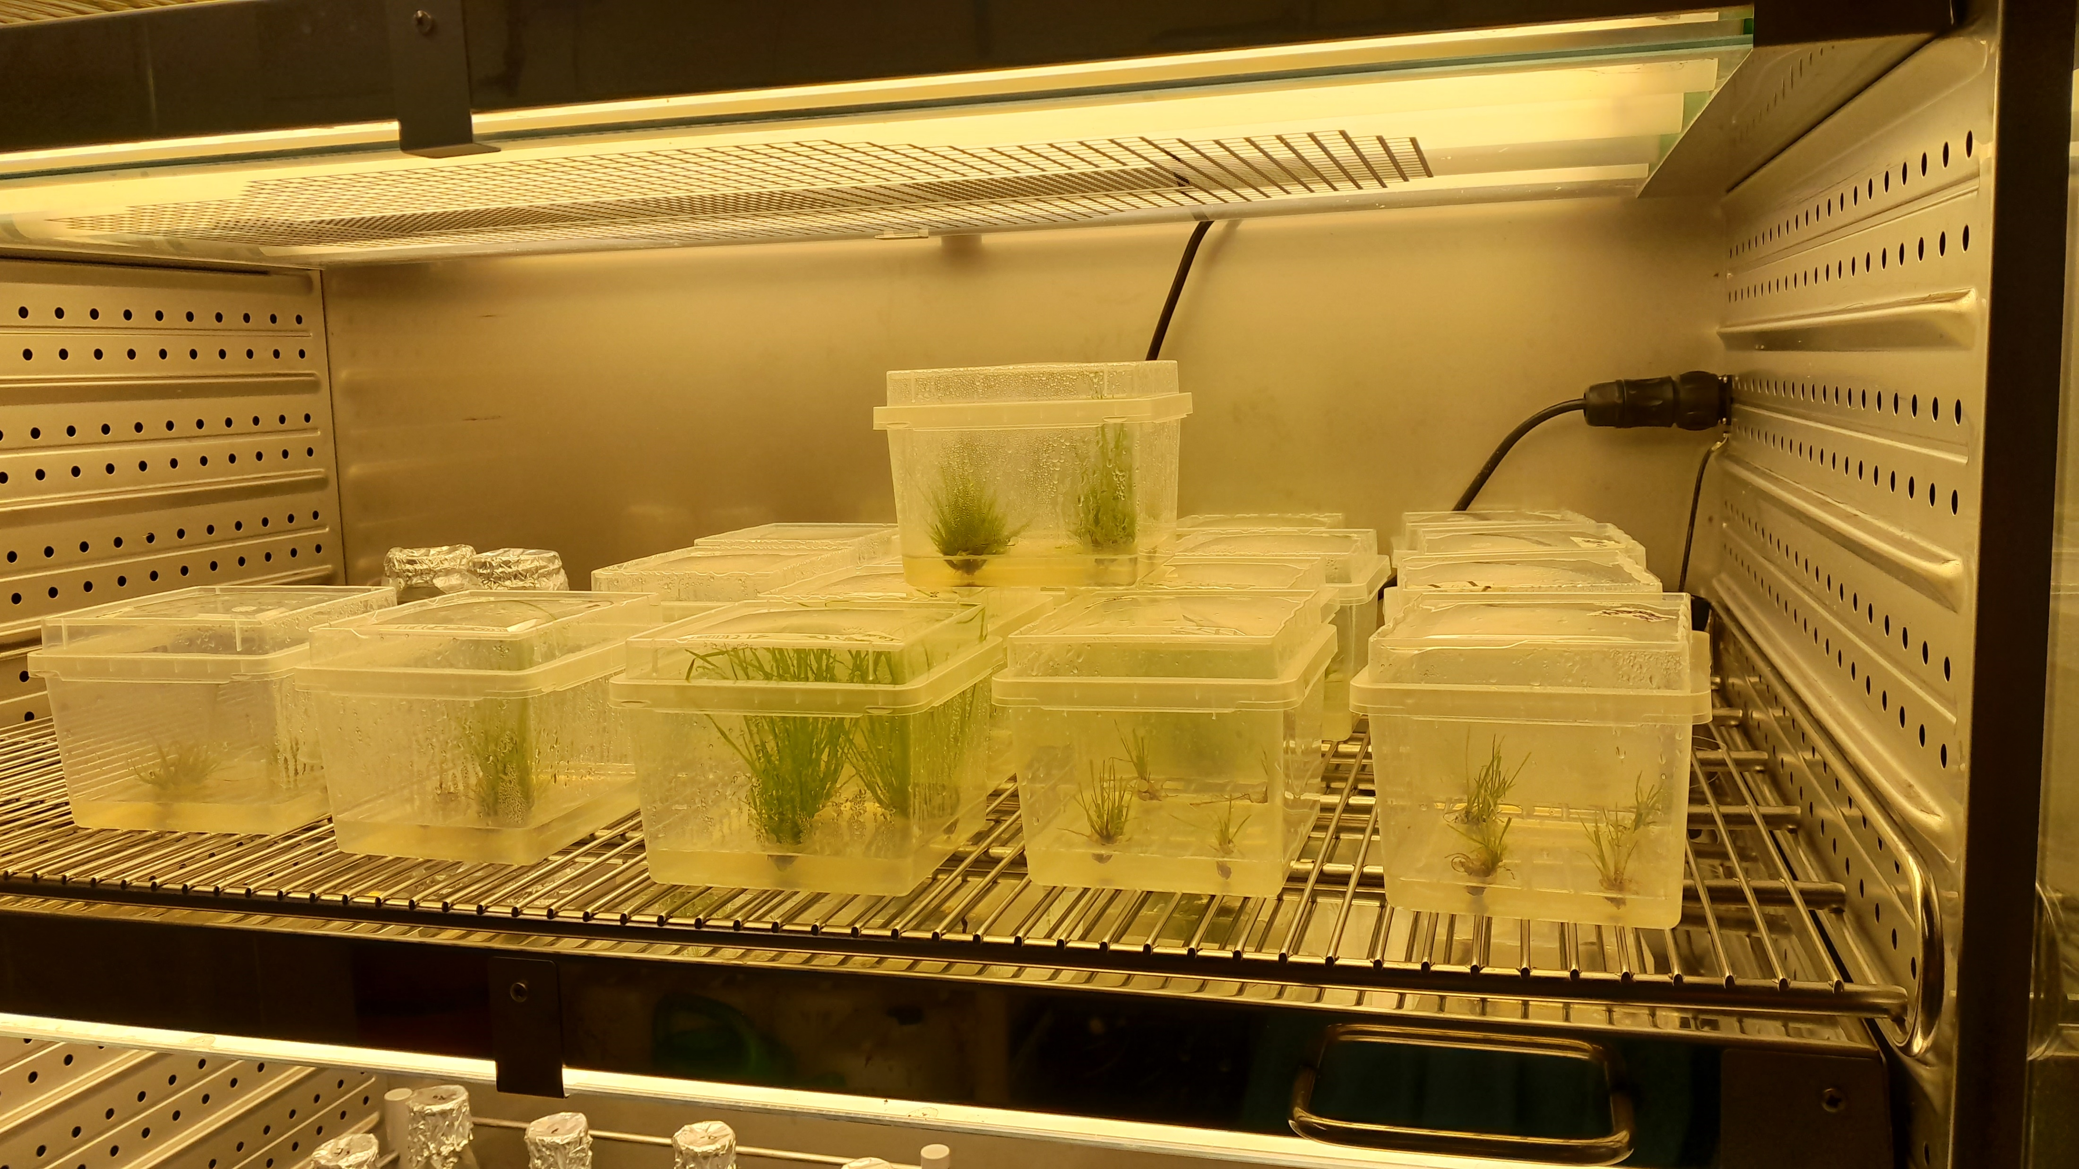
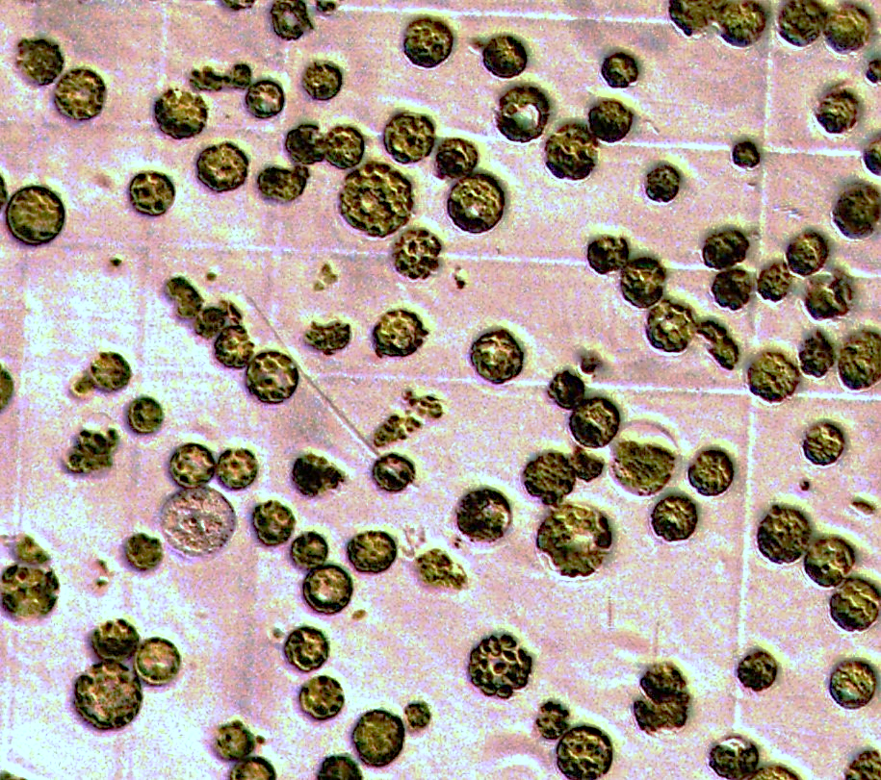
Development of protoplast protocol – for gRNA screen/selection
Switched to growing plants in boxes in vitro (currently only cv. ‘Veja’)
Tested the protocol by Davis et al. 2020* - low and inconsistent yield
Working based on the protocol by Brandt et al. 2020** - 1.3*10^5 pp/ml
Gathering data for the planned publication together with Talltech team - testing several factors:
tissue disintegration – cutting vs blending
other factors will be tested – as agreed with Ferenz
* Davis, H.R., Maddison, A.L., Phillips, D.W. and Jones, H.D., 2020. Genetic transformation of protoplasts isolated from leaves of Lolium temulentum and Lolium perenne. Cereal Genomics: Methods and Protocols, pp.199-205.
**Brandt, K.M., Gunn, H., Moretti, N. and Zemetra, R.S., 2020. A streamlined protocol for wheat (Triticum aestivum) protoplast isolation and transformation with CRISPR-Cas ribonucleoprotein complexes. Frontiers in Plant Science, 11, p.769.

Slide 7
Summary
We have plasmid constructs ready for 2 genes – CBP20 and CBP60G
We know how to obtain protoplasts
Next:
1) Protoplast transformations for gRNA testing
2) Data acquisition for publication on protoplast isolation
3) Plasmid constructs from other genes
4) Plant (callus) transformation

